Slide 2
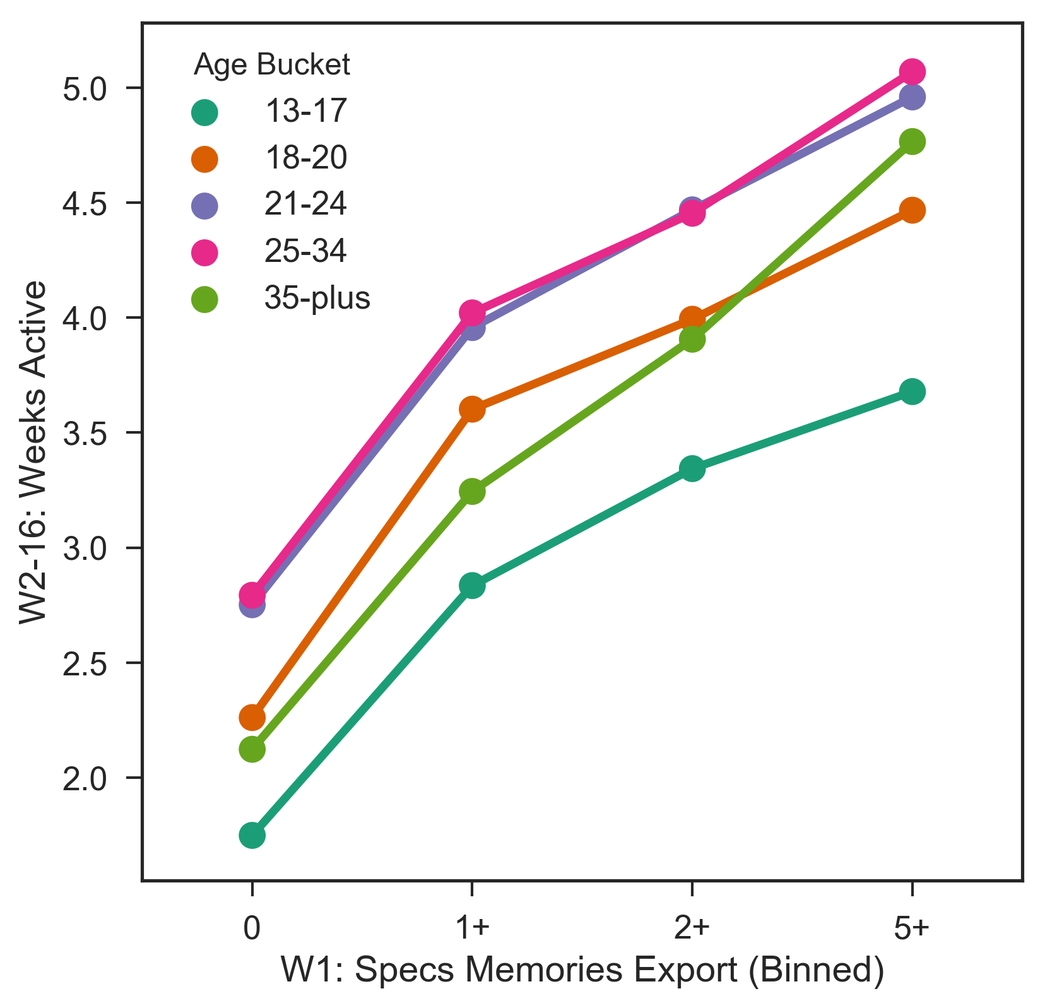
W2-16: Weeks Active ~ W1: Specs Memories Export (Binned) + Age Bucket - 16 Week Window

Slide 3
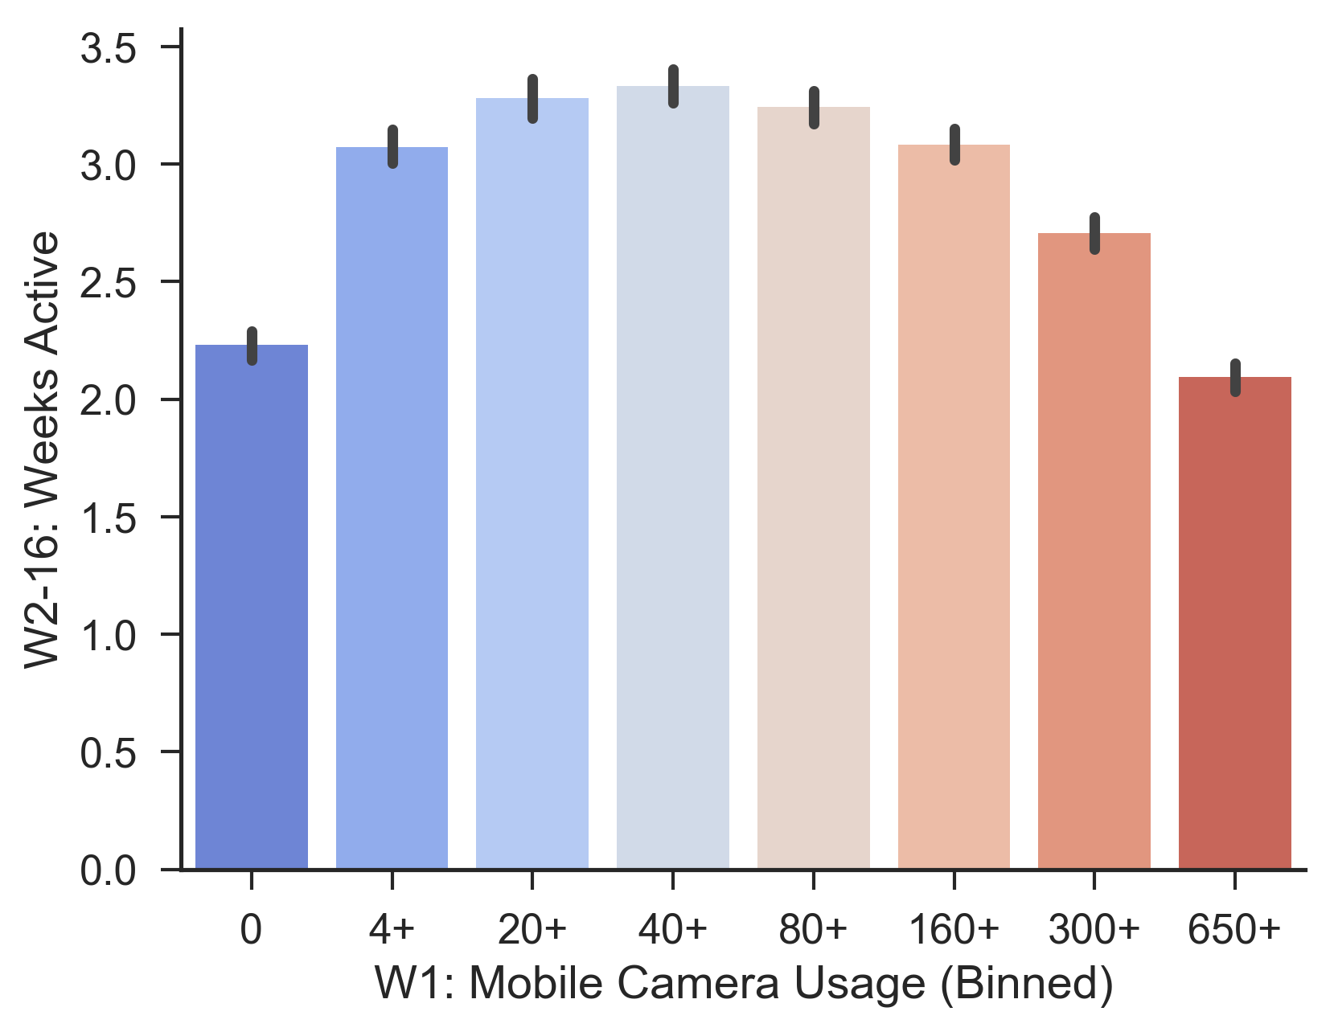
W2-16: Weeks Active ~ W1 Mobile Camera Usage (Binned) - First 16 Weeks

Slide 4
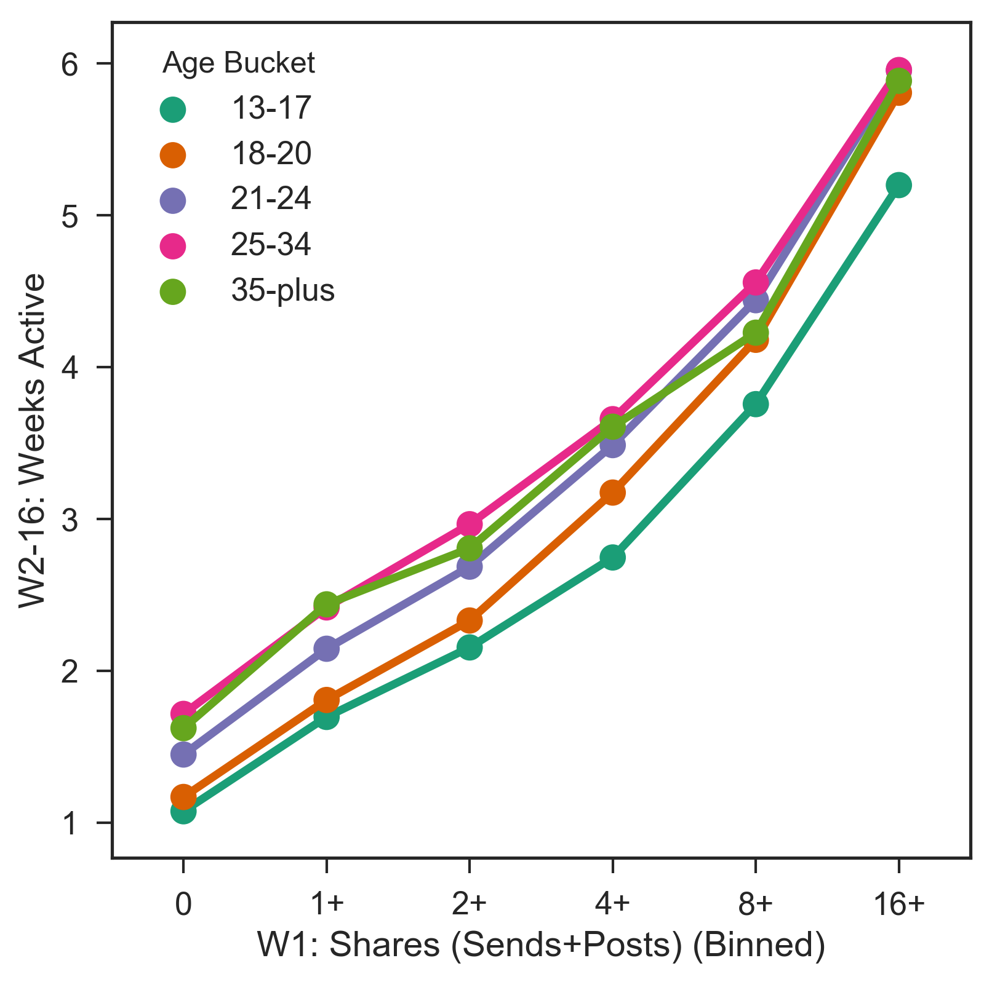
W2-16: Weeks Active ~ W1: Shares (Sends+Posts) (Binned) + Age Bucket - 16 Week Window

Slide 5
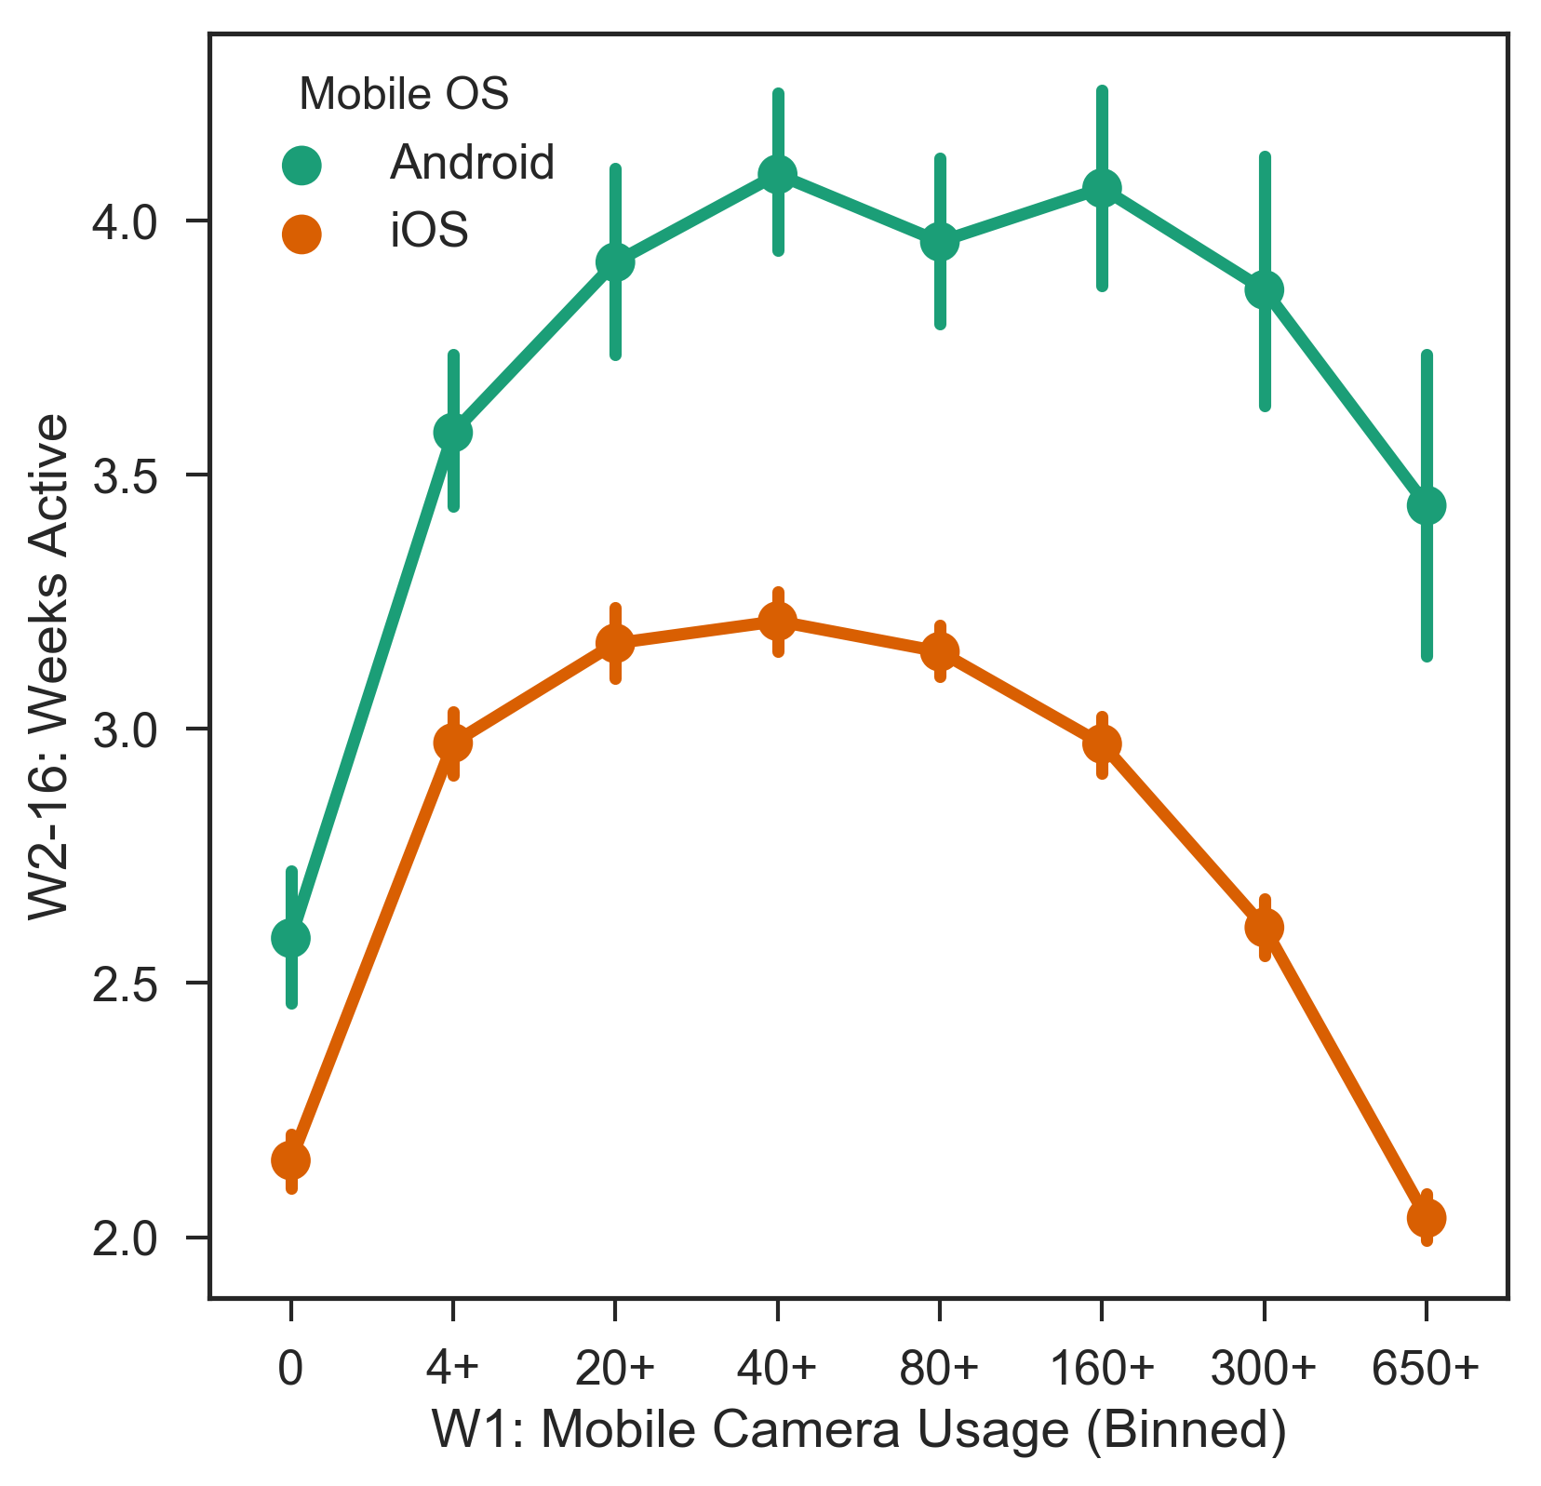
W2-16: Weeks Active ~ W1: Mobile Camera Usage (Binned) + Mobile OS - 16 Week Window

Slide 6
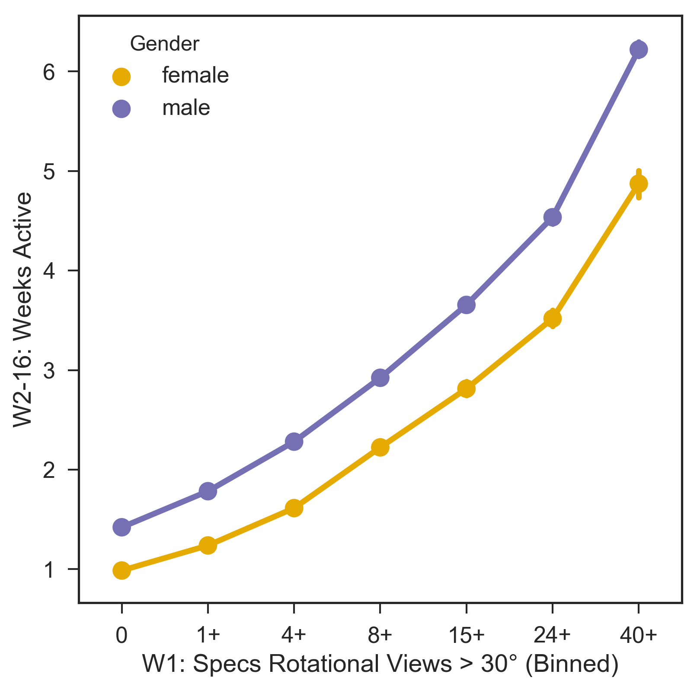
W2-16: Weeks Active ~ W1: Specs Rotational Views > 30° (Binned) + Gender - 16 Week Window

Slide 7
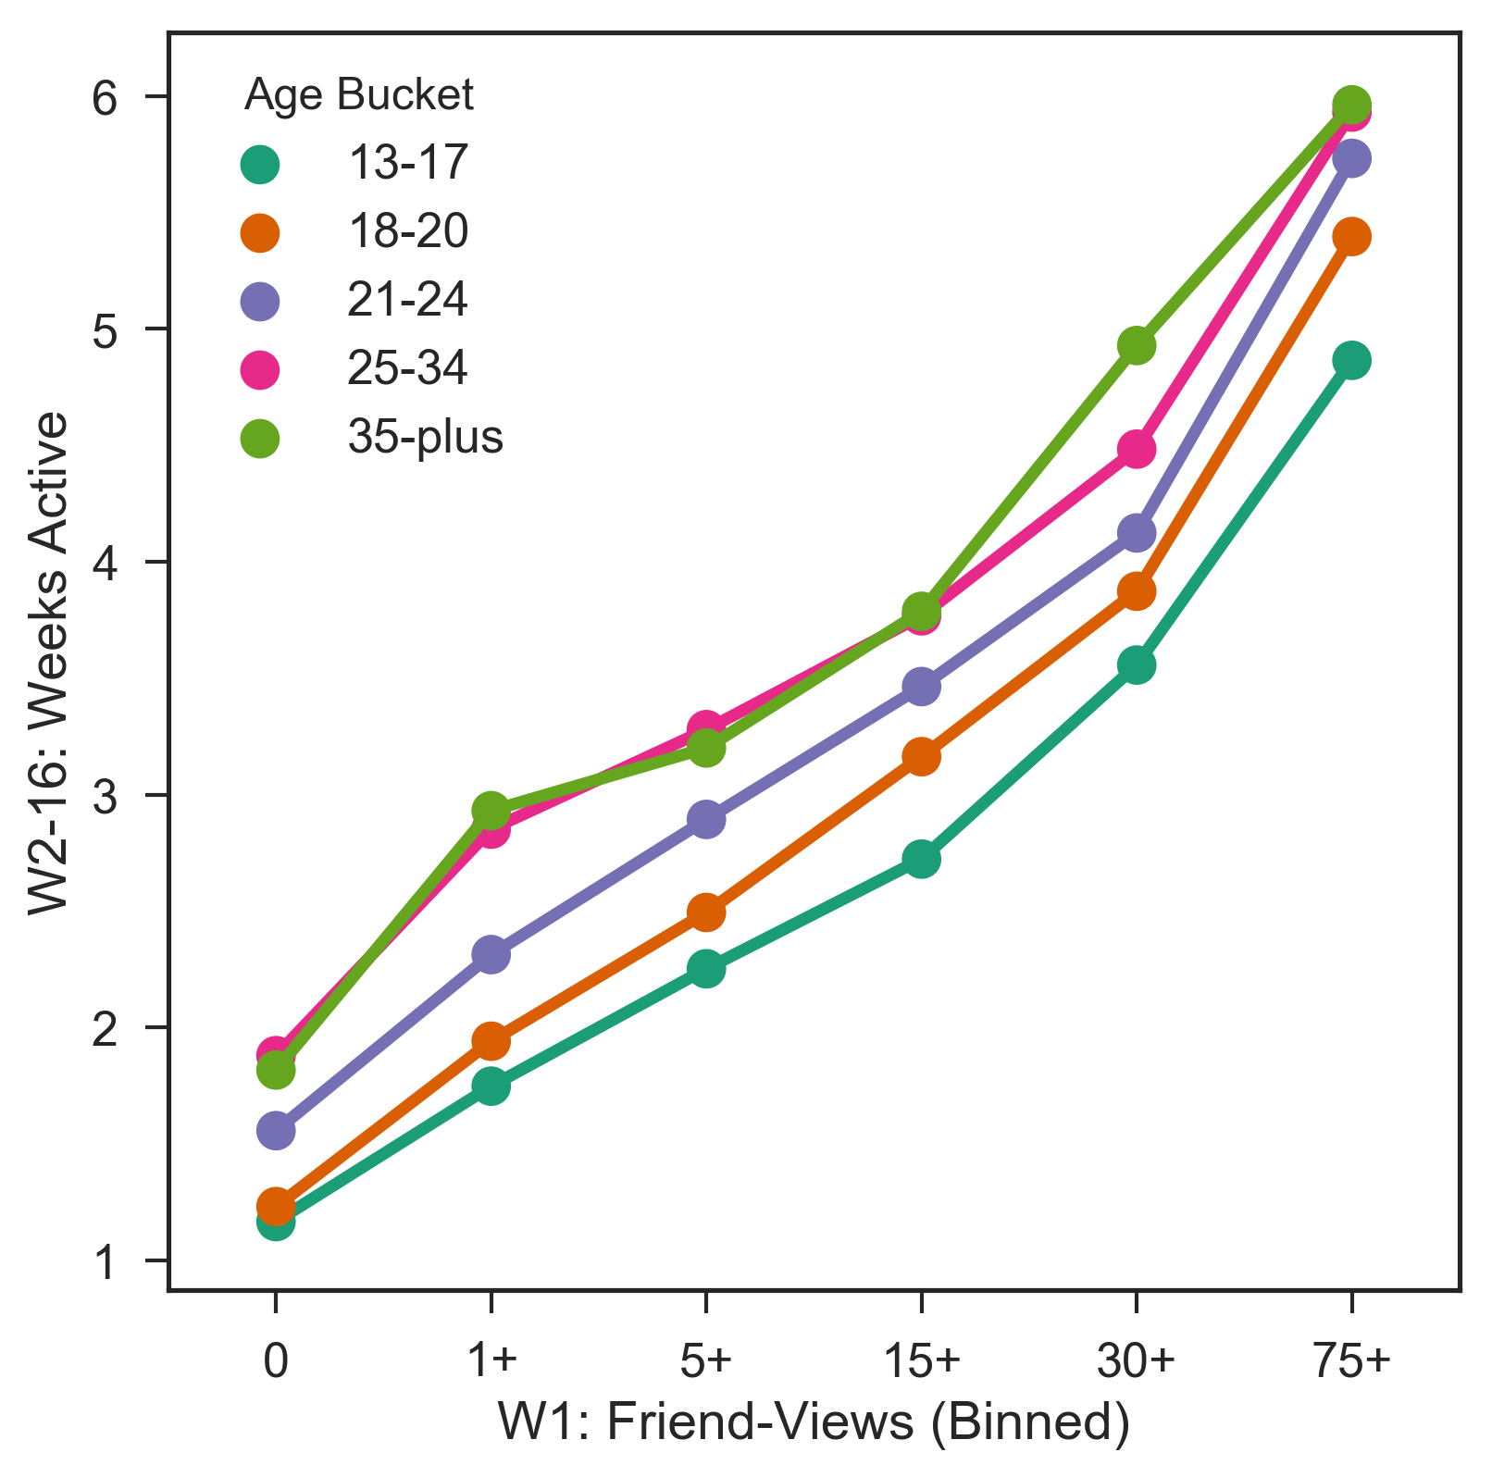
W2-16: Weeks Active ~ W1: Friend-Views (Binned) + Age Bucket - 16 Week Window

Slide 8
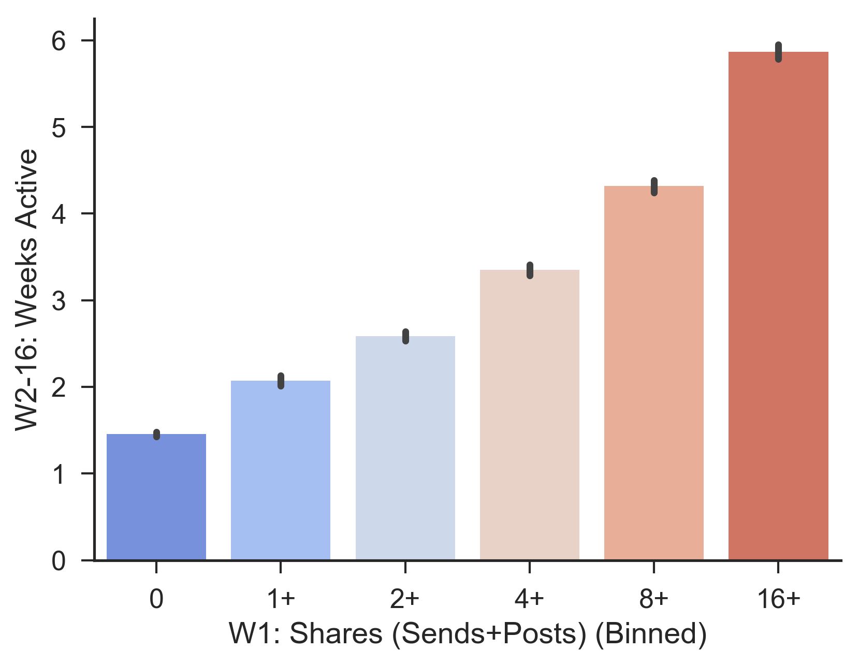
W2-16: Weeks Active ~ W1 Shares (Sends+Posts) (Binned) - First 16 Weeks

Slide 9
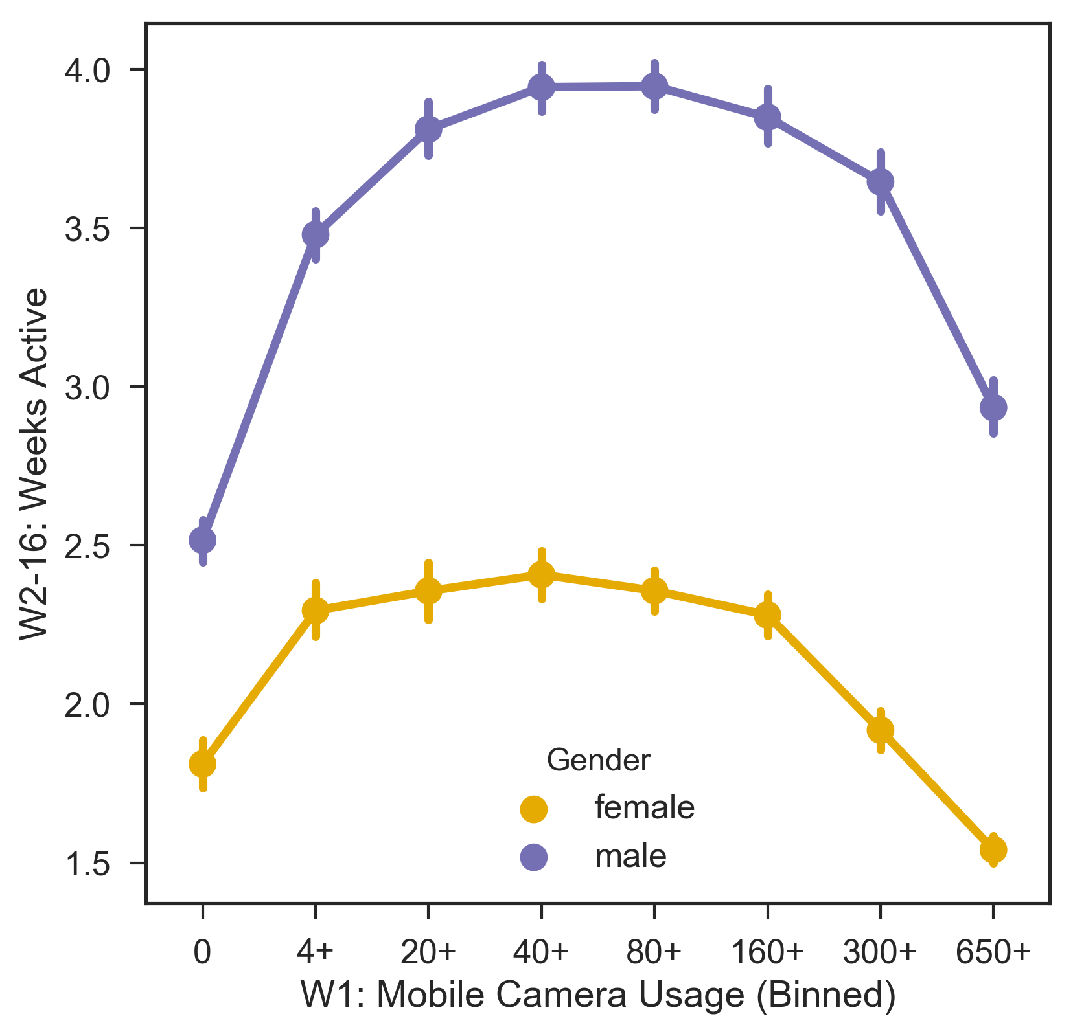
W2-16: Weeks Active ~ W1: Mobile Camera Usage (Binned) + Gender - 16 Week Window

Slide 10
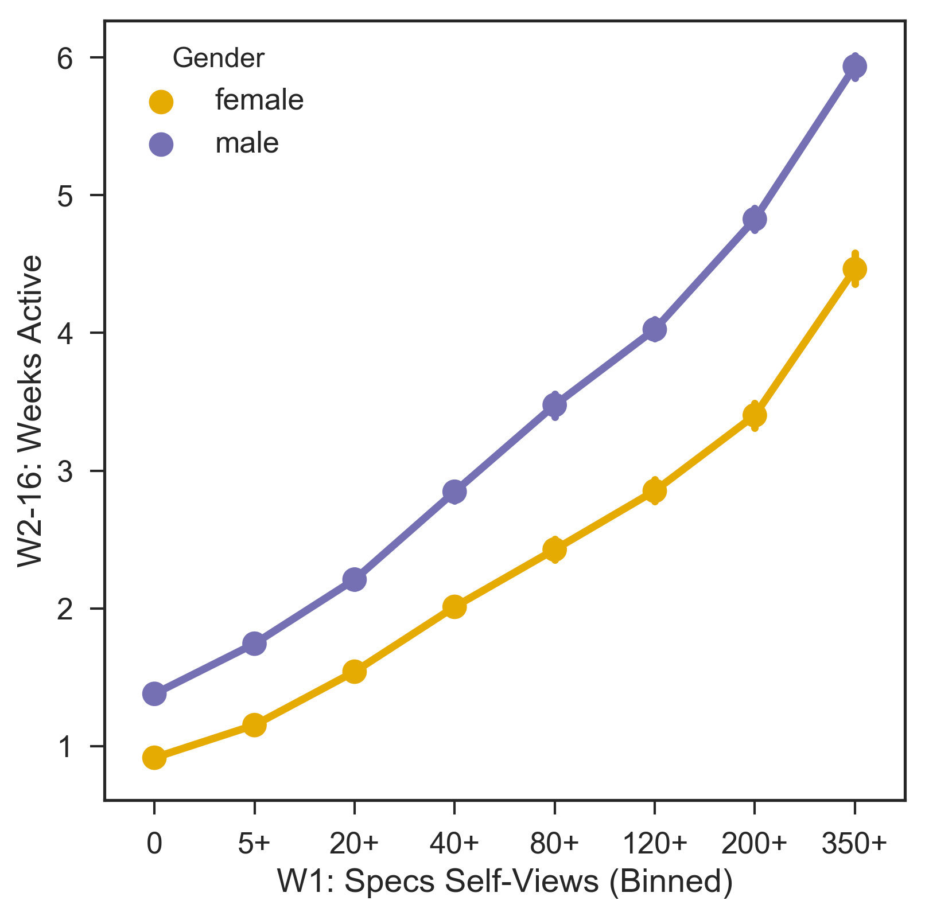
W2-16: Weeks Active ~ W1: Specs Self-Views (Binned) + Gender - 16 Week Window

Slide 11
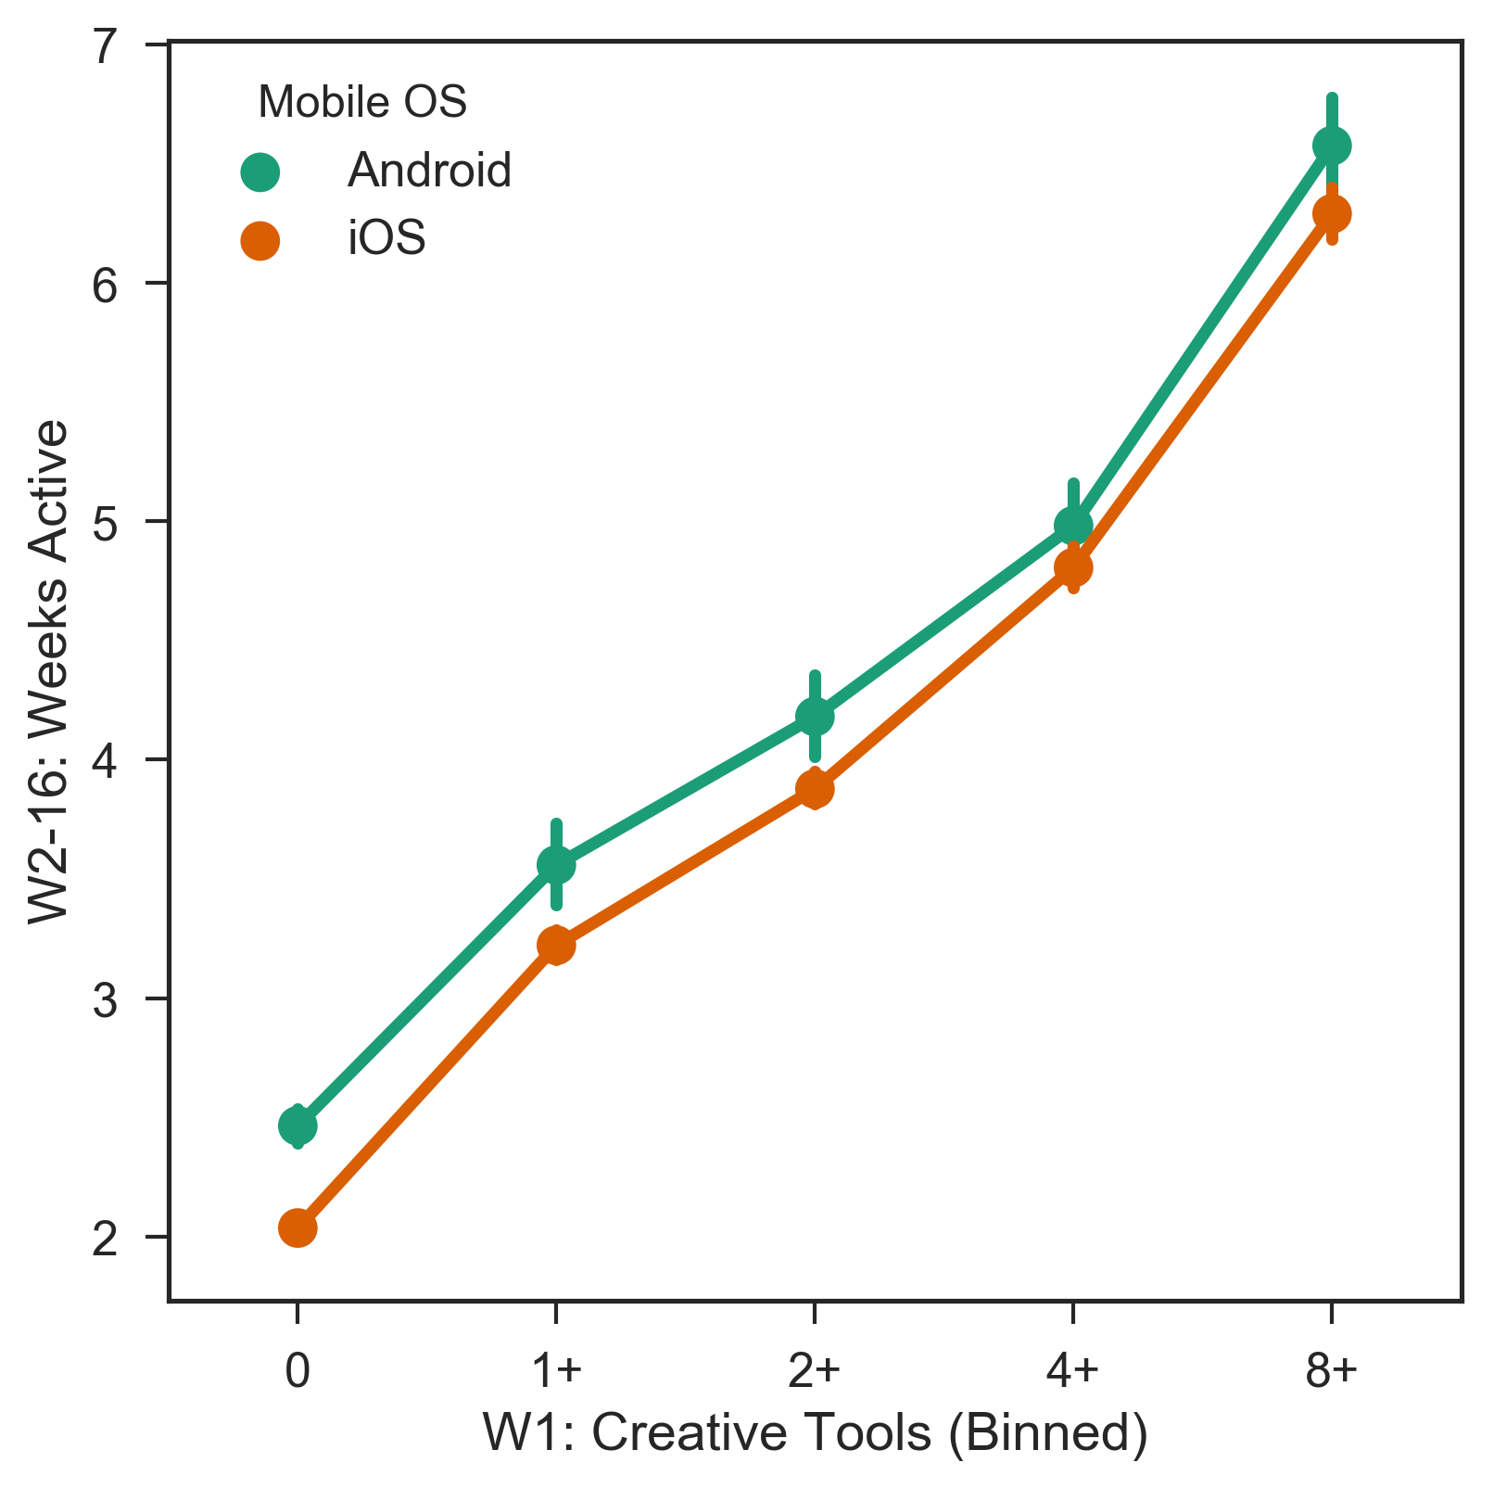
W2-16: Weeks Active ~ W1: Creative Tools (Binned) + Mobile OS - 16 Week Window

Slide 12
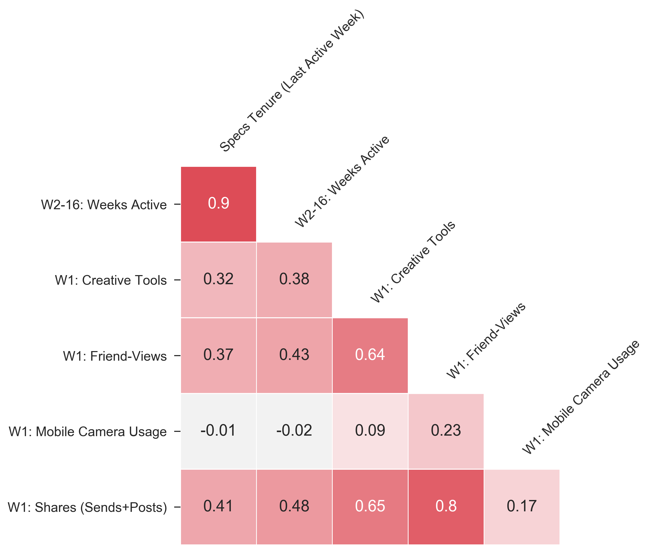
CORRELATION PLOT Short-Term Core App Engagement

Slide 13
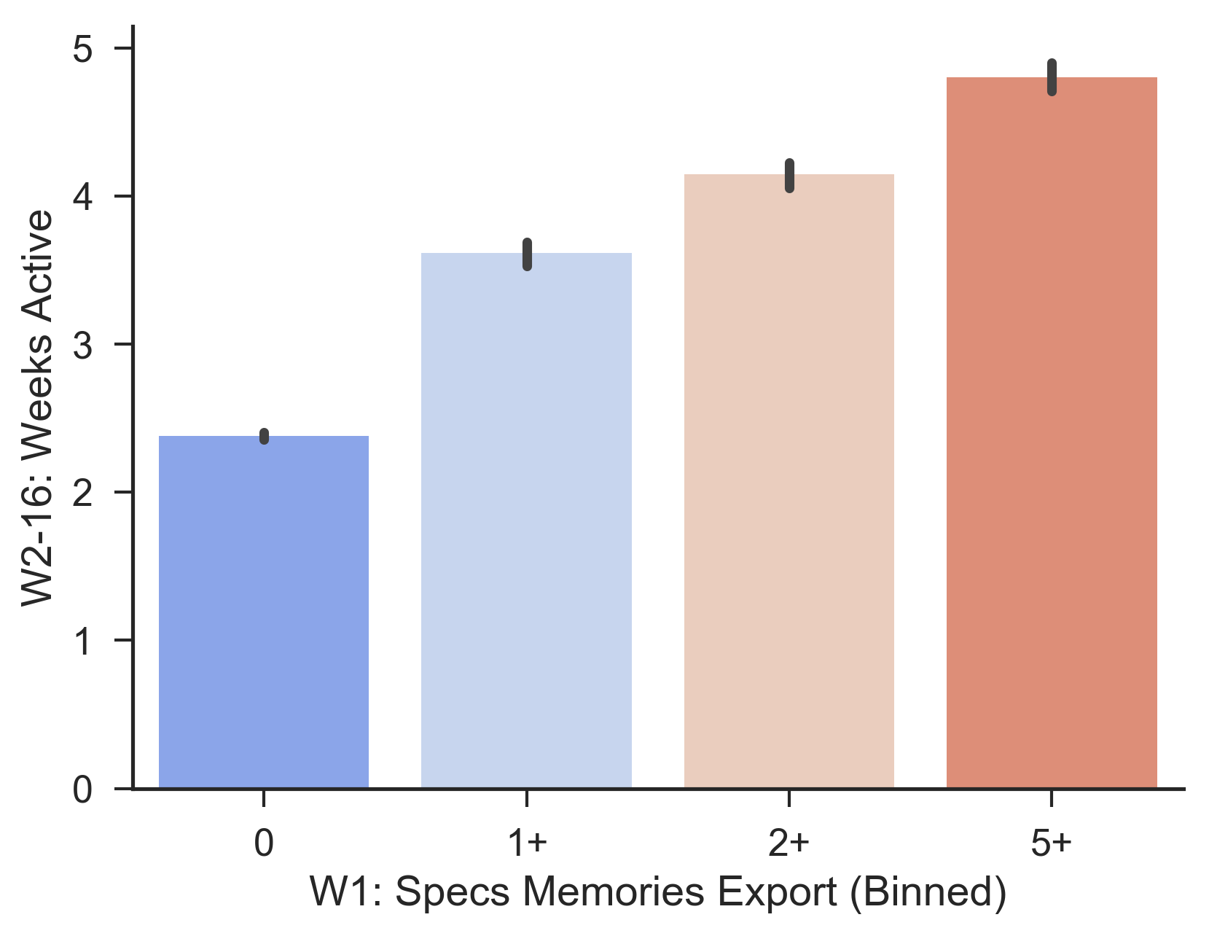
W2-16: Weeks Active ~ W1 Specs Memories Export (Binned) - First 16 Weeks

Slide 14
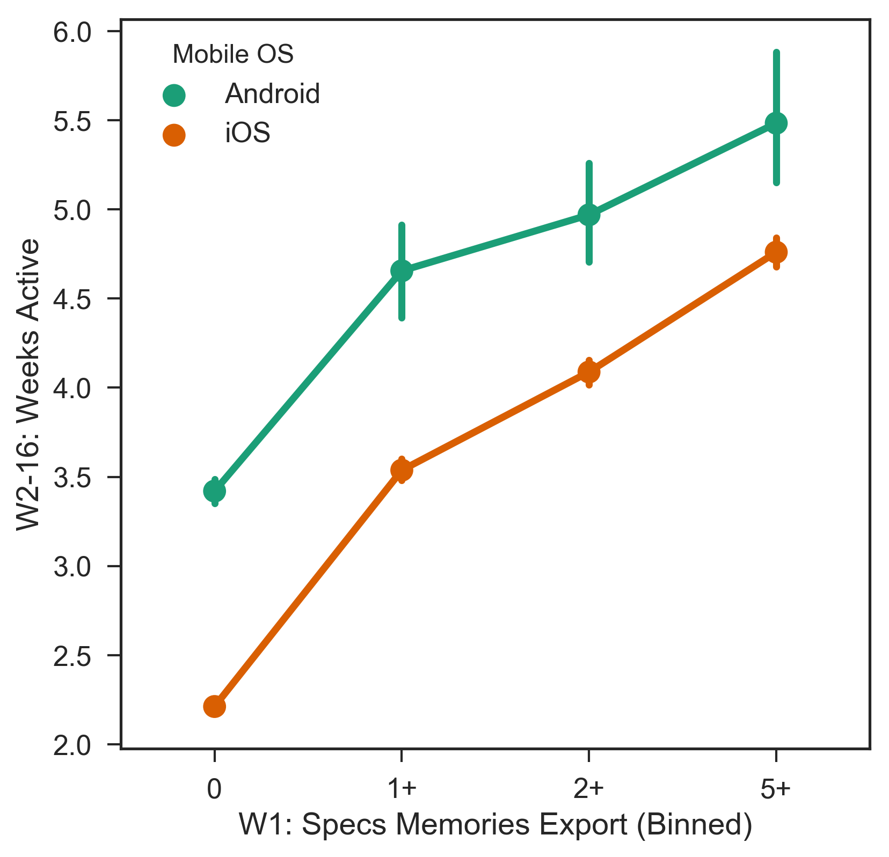
W2-16: Weeks Active ~ W1: Specs Memories Export (Binned) + Mobile OS - 16 Week Window

Slide 15
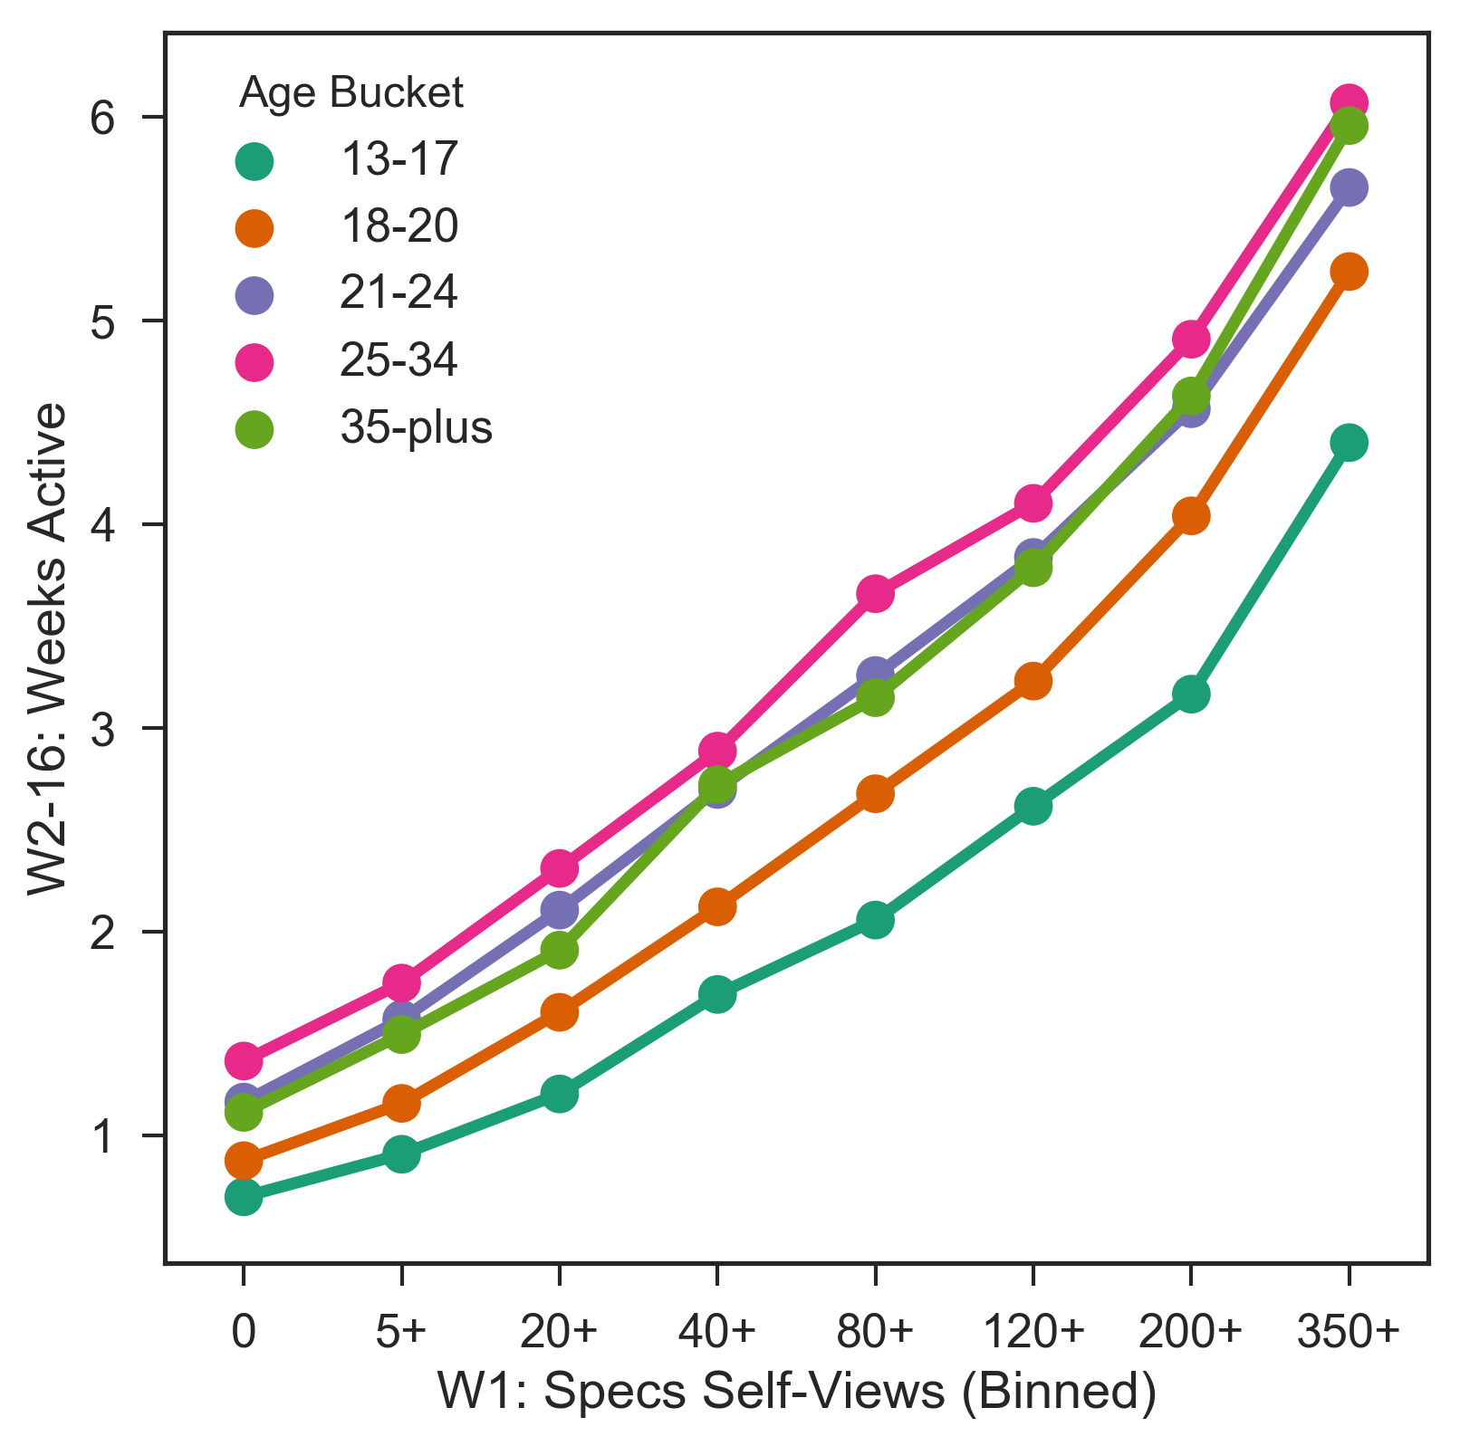
W2-16: Weeks Active ~ W1: Specs Self-Views (Binned) + Age Bucket - 16 Week Window

Slide 16
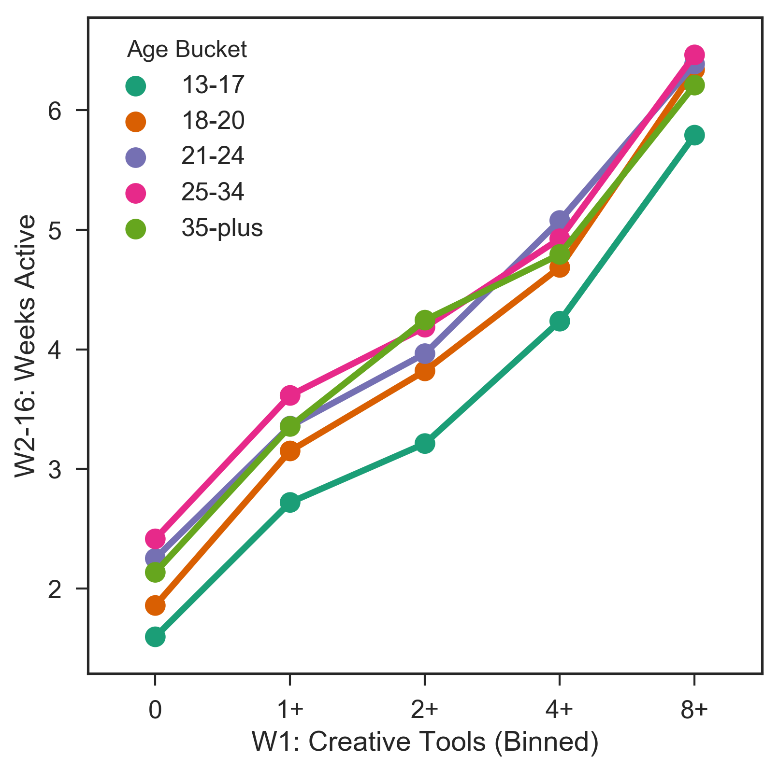
W2-16: Weeks Active ~ W1: Creative Tools (Binned) + Age Bucket - 16 Week Window

Slide 17
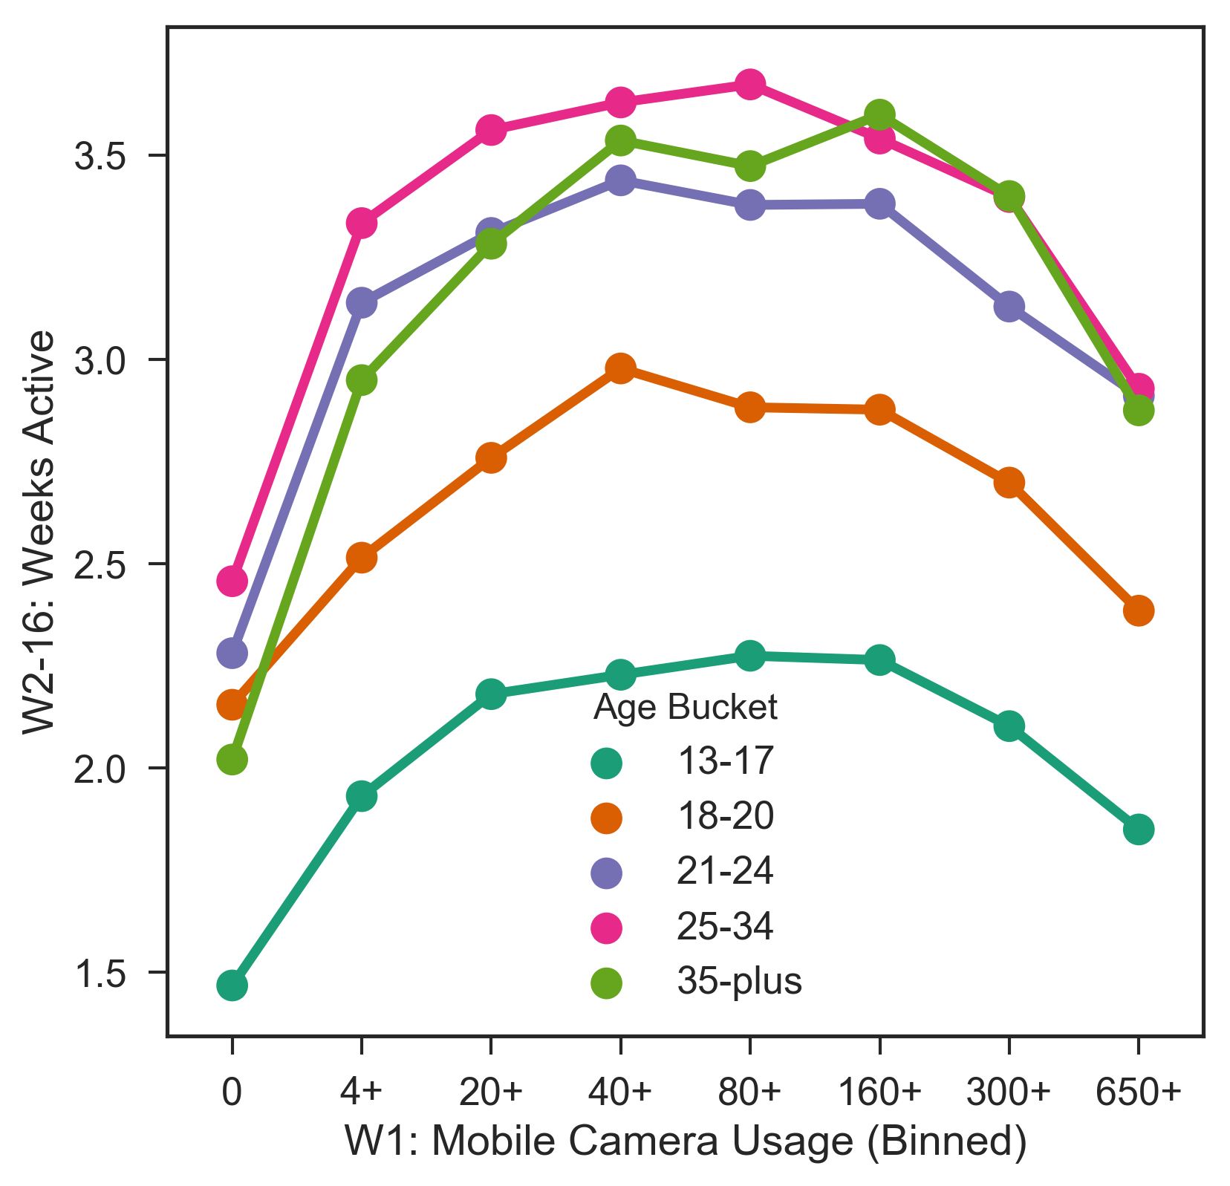
W2-16: Weeks Active ~ W1: Mobile Camera Usage (Binned) + Age Bucket - 16 Week Window

Slide 18

W2-16: Weeks Active ~ W1 Friend-Views (Binned) - First 16 Weeks

Slide 19
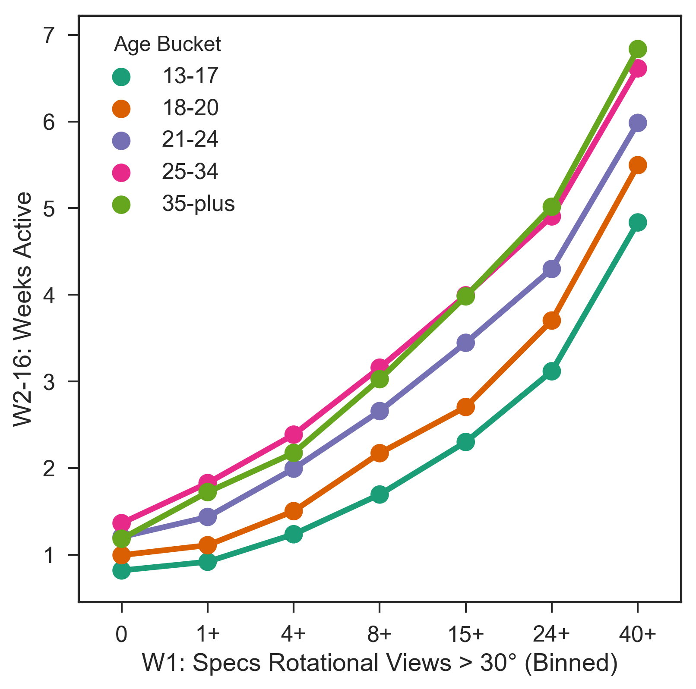
W2-16: Weeks Active ~ W1: Specs Rotational Views > 30° (Binned) + Age Bucket - 16 Week Window

Slide 20
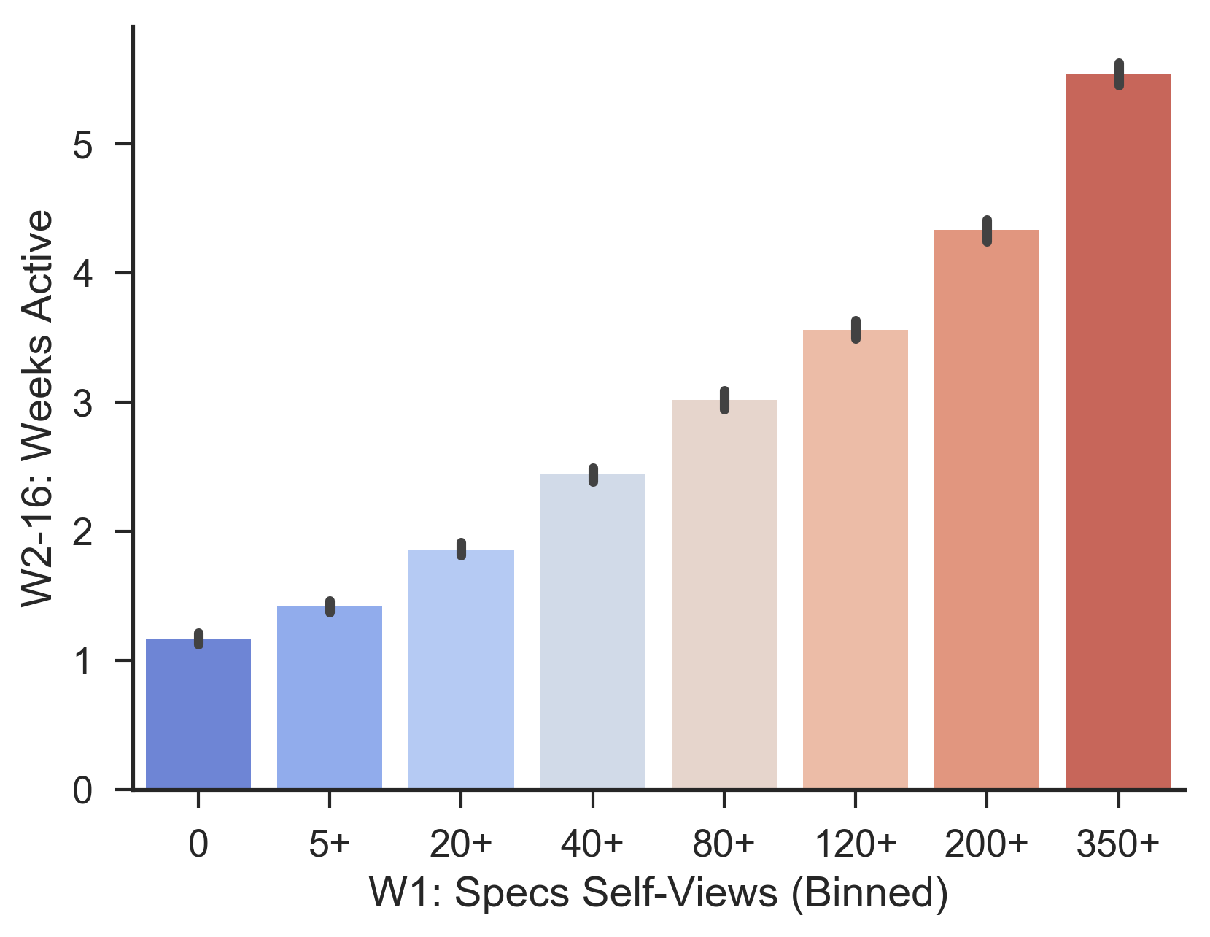
W2-16: Weeks Active ~ W1 Specs Self-Views (Binned) - First 16 Weeks

Slide 21
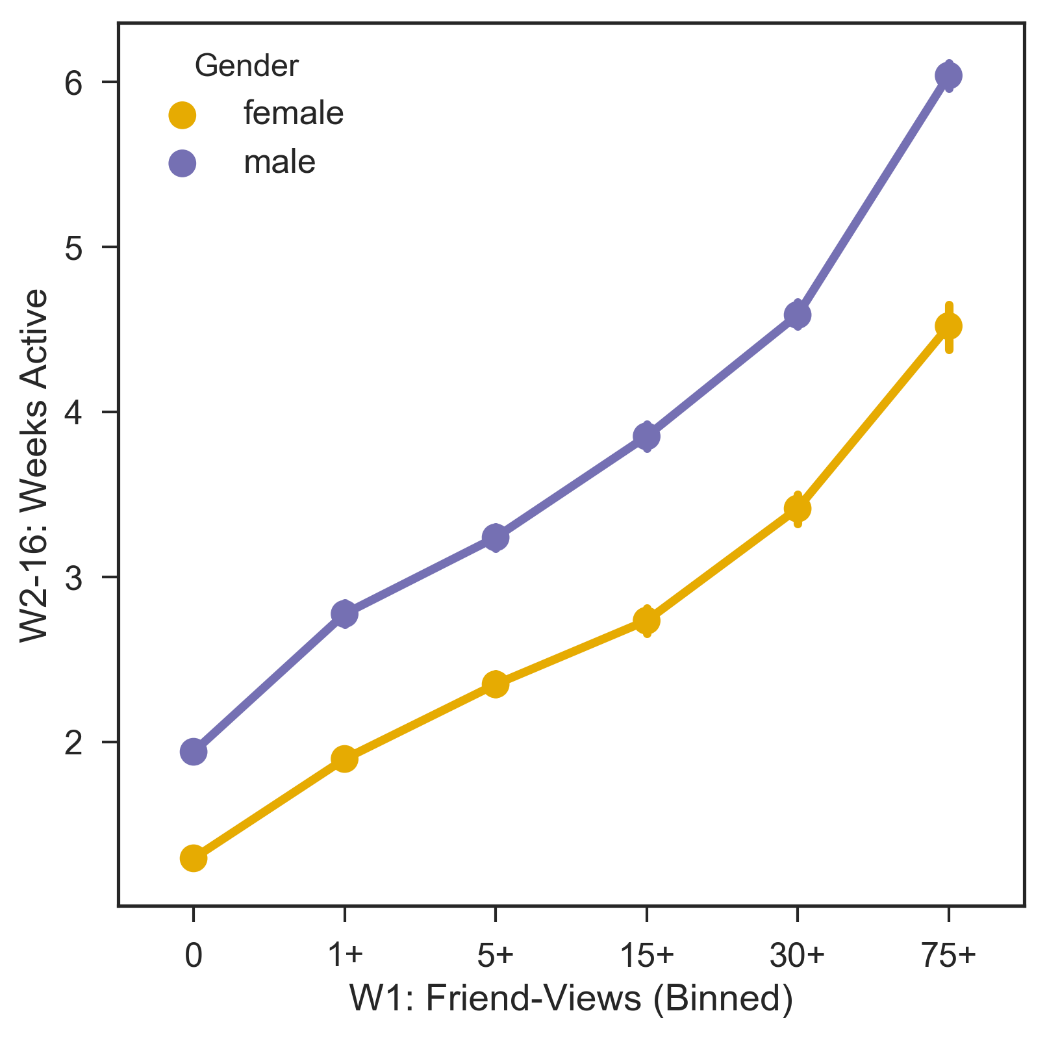
W2-16: Weeks Active ~ W1: Friend-Views (Binned) + Gender - 16 Week Window

Slide 22
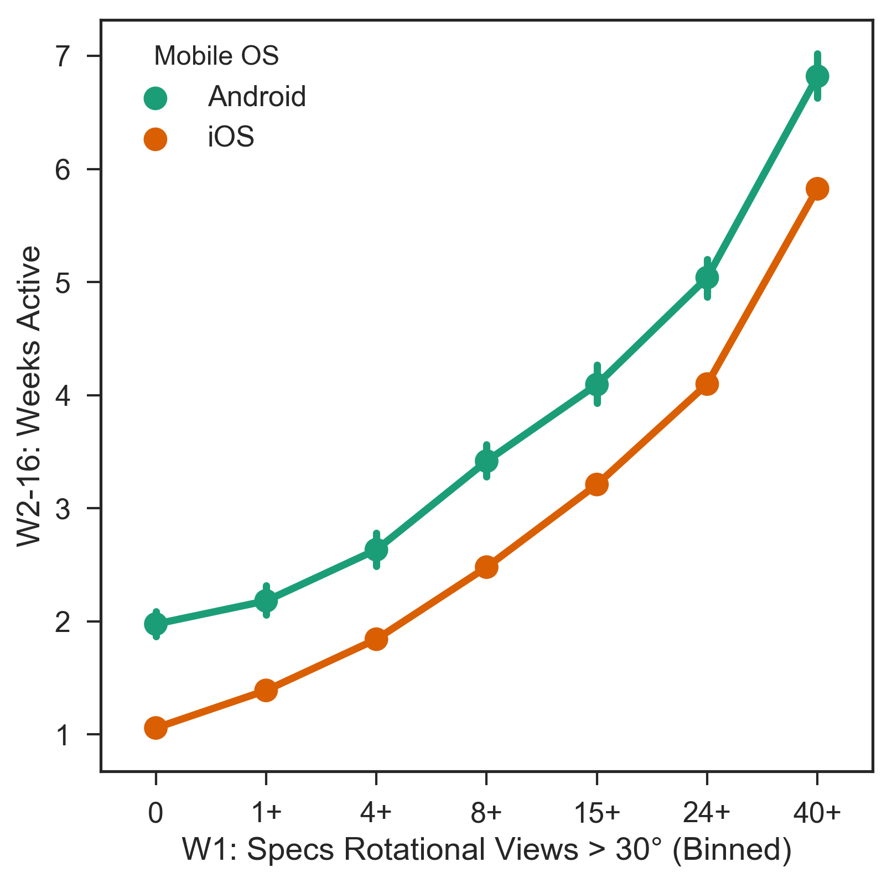
W2-16: Weeks Active ~ W1: Specs Rotational Views > 30° (Binned) + Mobile OS - 16 Week Window

Slide 23
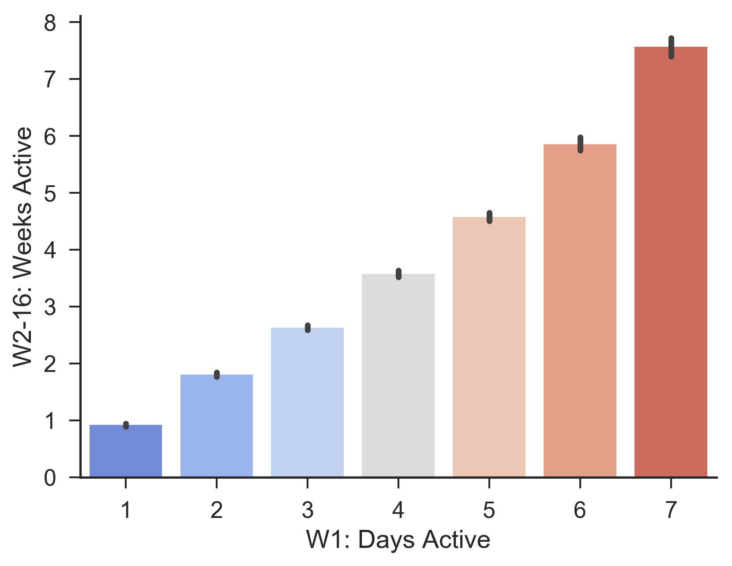
W2-16: Weeks Active ~ W1 Days Active - First 16 Weeks

Slide 24
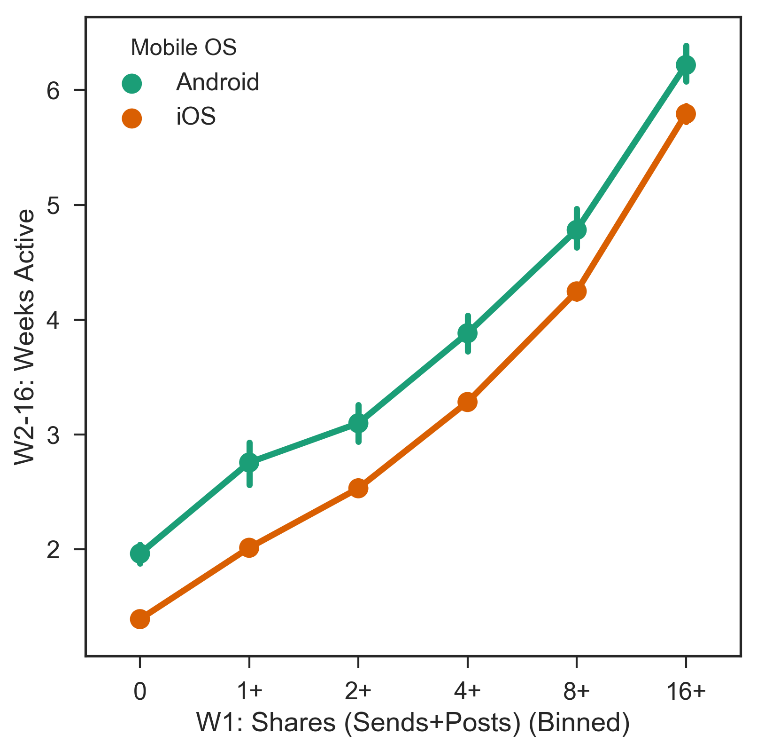
W2-16: Weeks Active ~ W1: Shares (Sends+Posts) (Binned) + Mobile OS - 16 Week Window

Slide 25
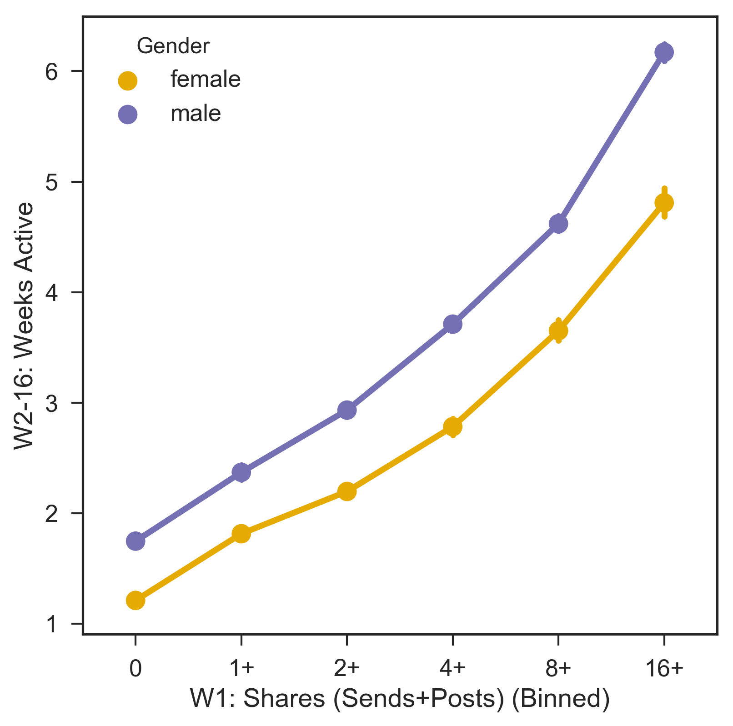
W2-16: Weeks Active ~ W1: Shares (Sends+Posts) (Binned) + Gender - 16 Week Window

Slide 26
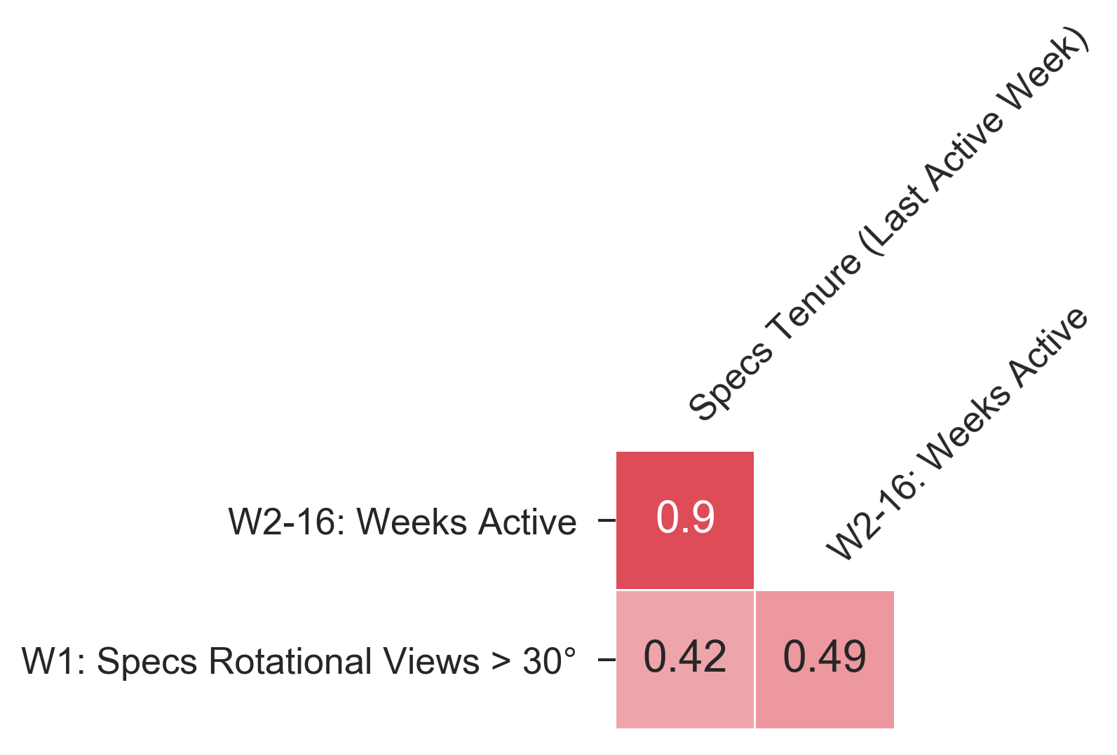
CORRELATION PLOT Rotational Views

Slide 27
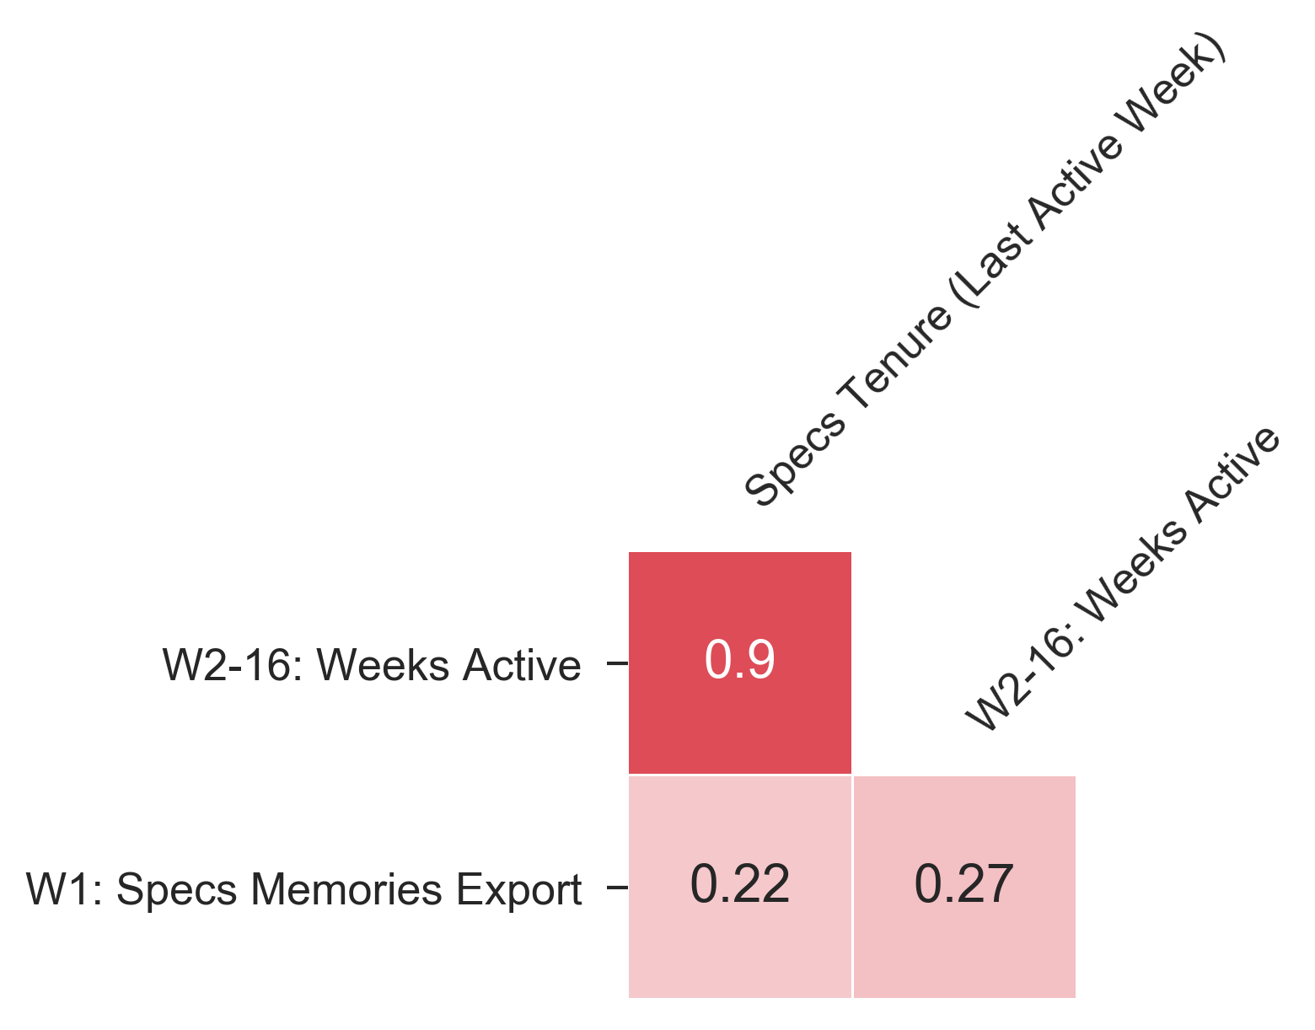
CORRELATION PLOT Exports

Slide 28
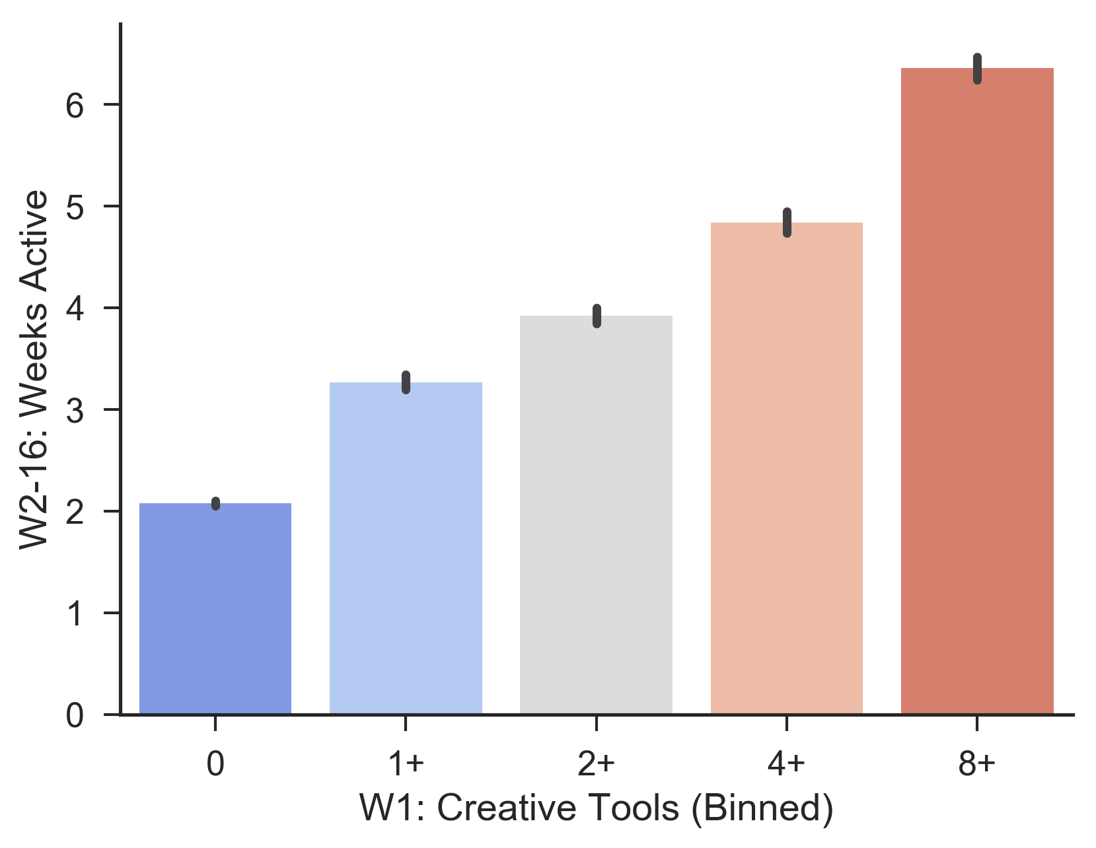
W2-16: Weeks Active ~ W1 Creative Tools (Binned) - First 16 Weeks

Slide 29
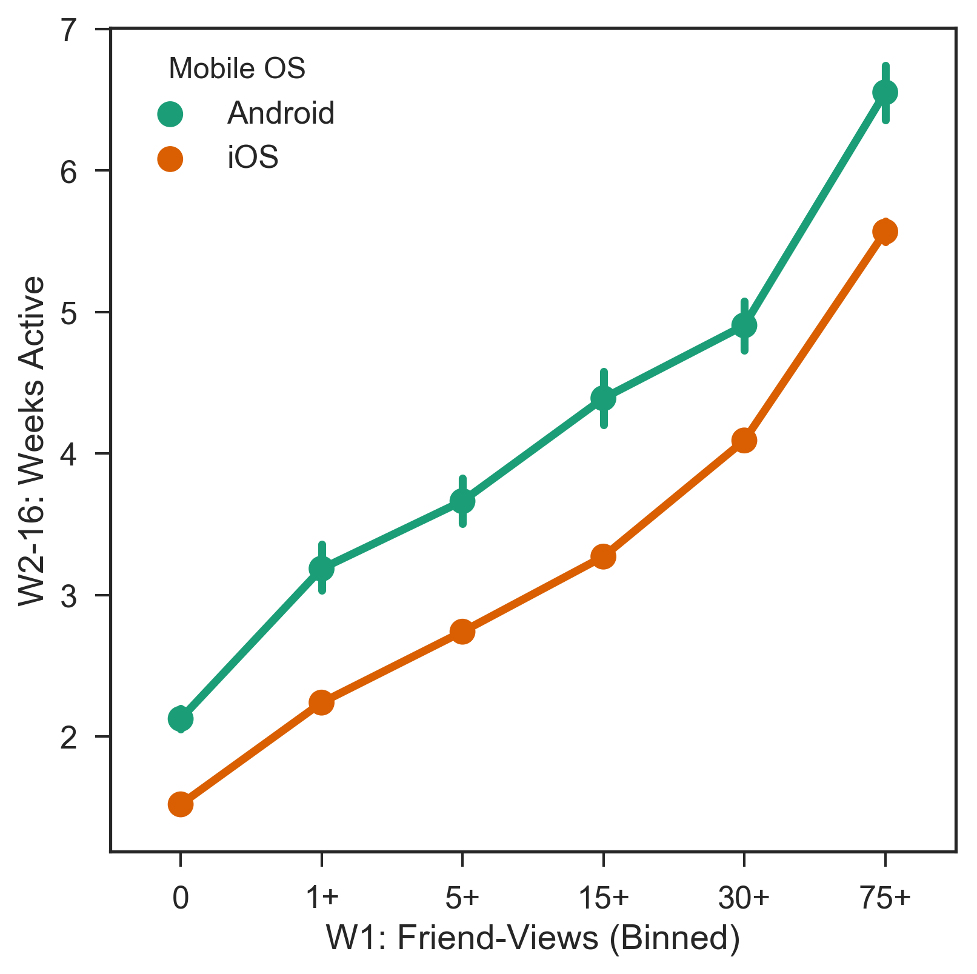
W2-16: Weeks Active ~ W1: Friend-Views (Binned) + Mobile OS - 16 Week Window

Slide 30
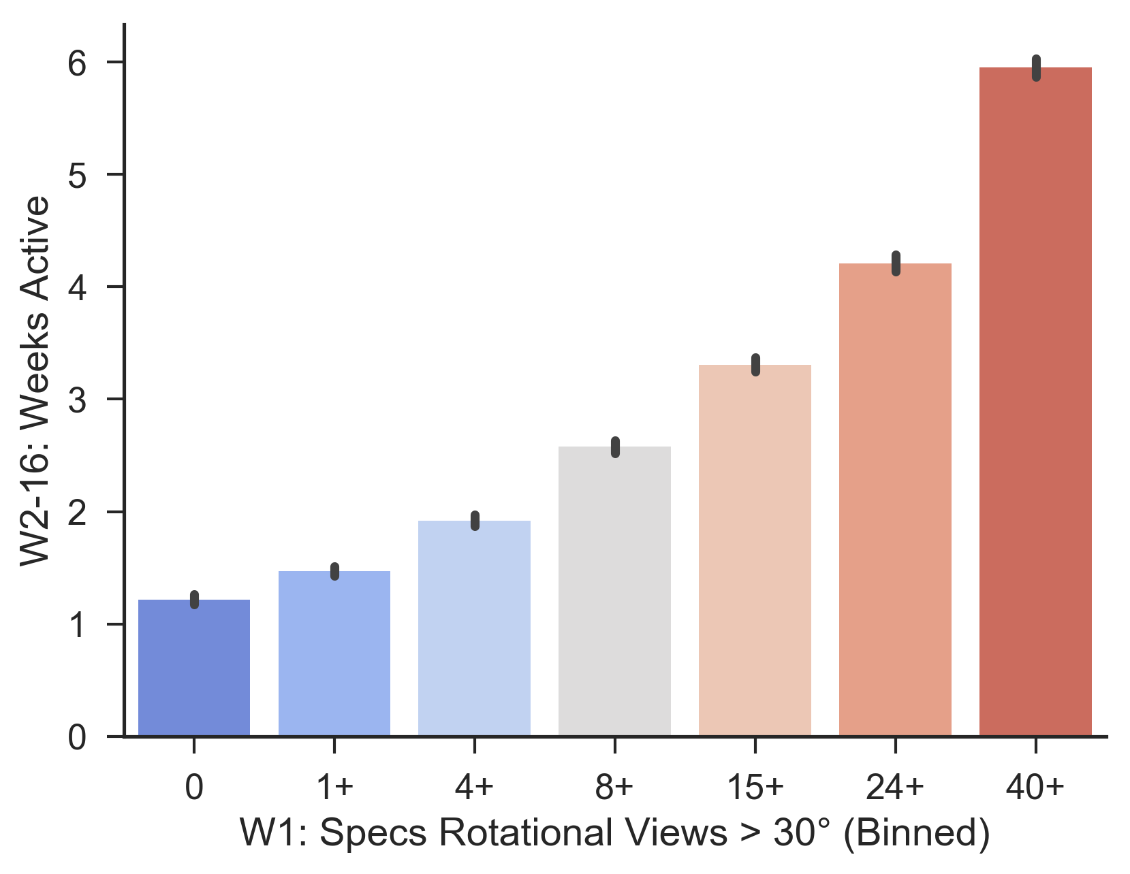
W2-16: Weeks Active ~ W1 Specs Rotational Views > 30° (Binned) - First 16 Weeks

Slide 31
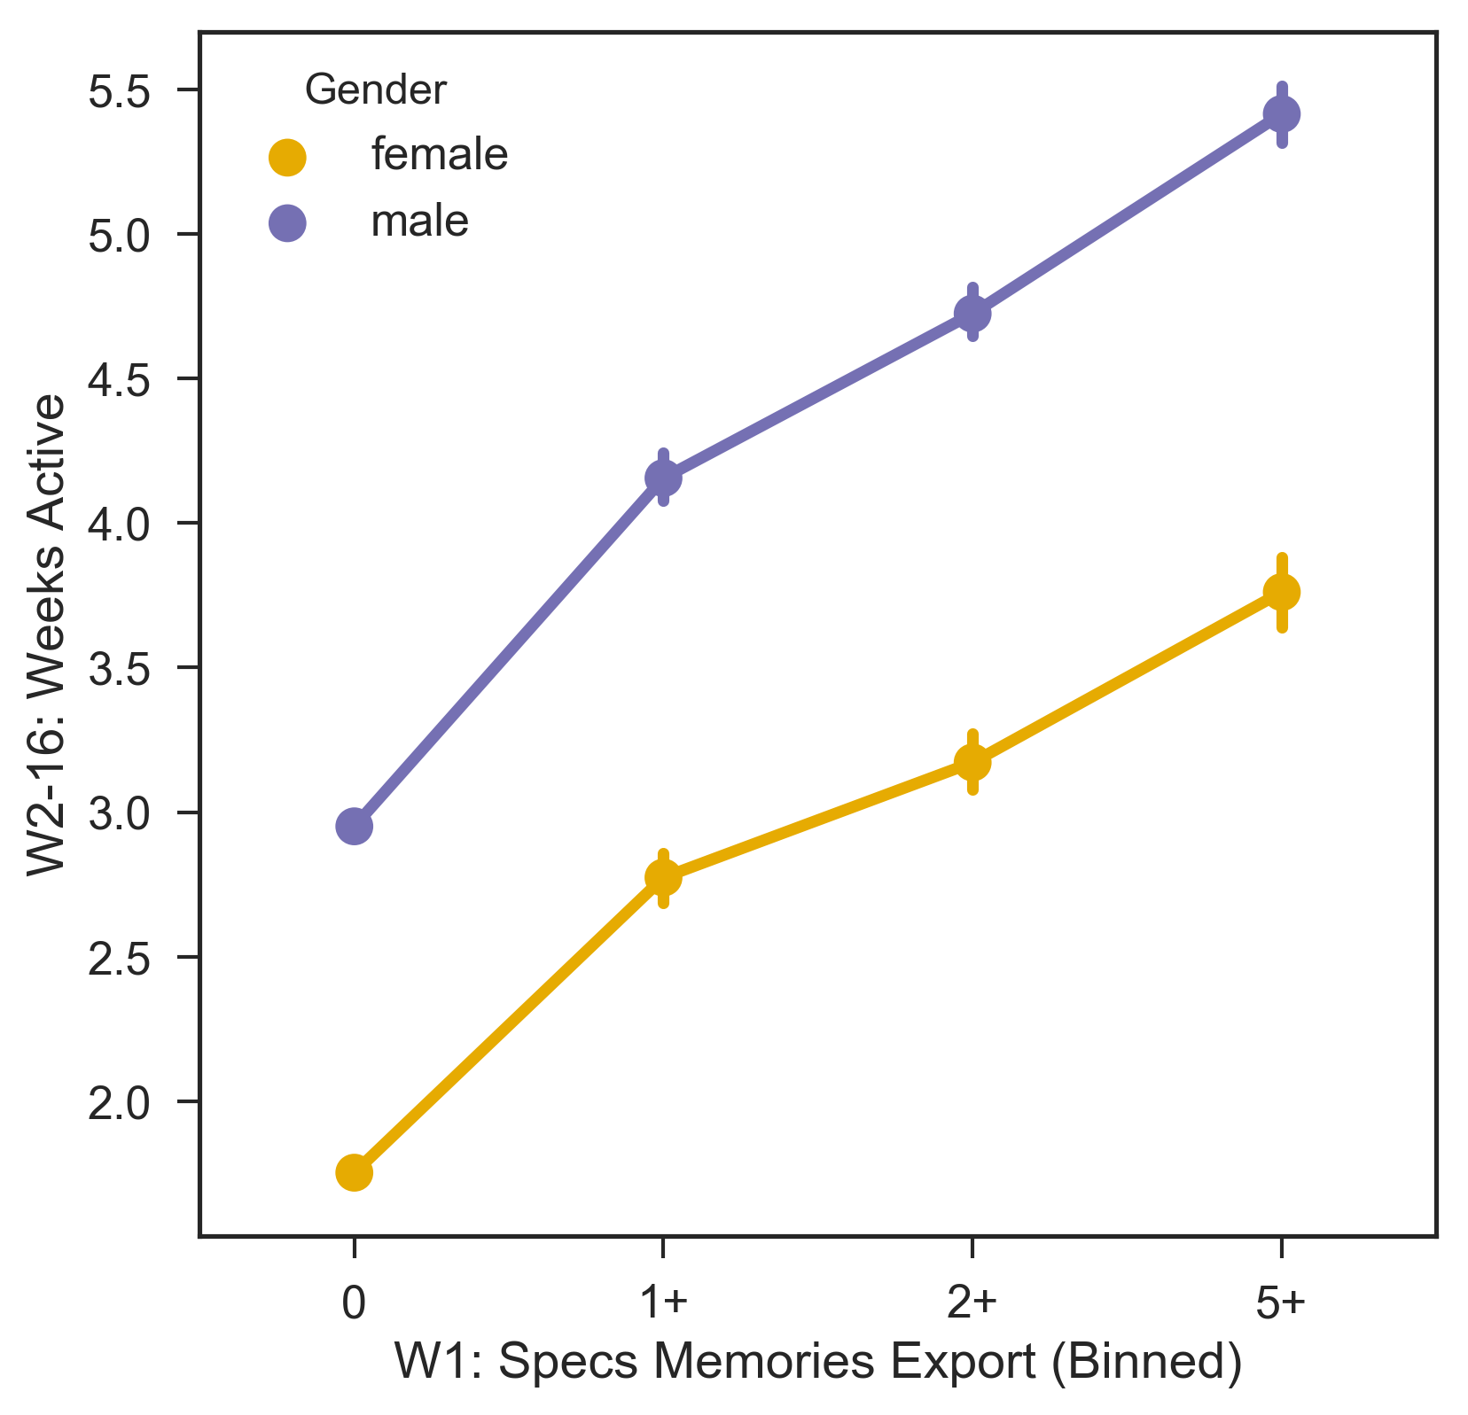
W2-16: Weeks Active ~ W1: Specs Memories Export (Binned) + Gender - 16 Week Window

Slide 32
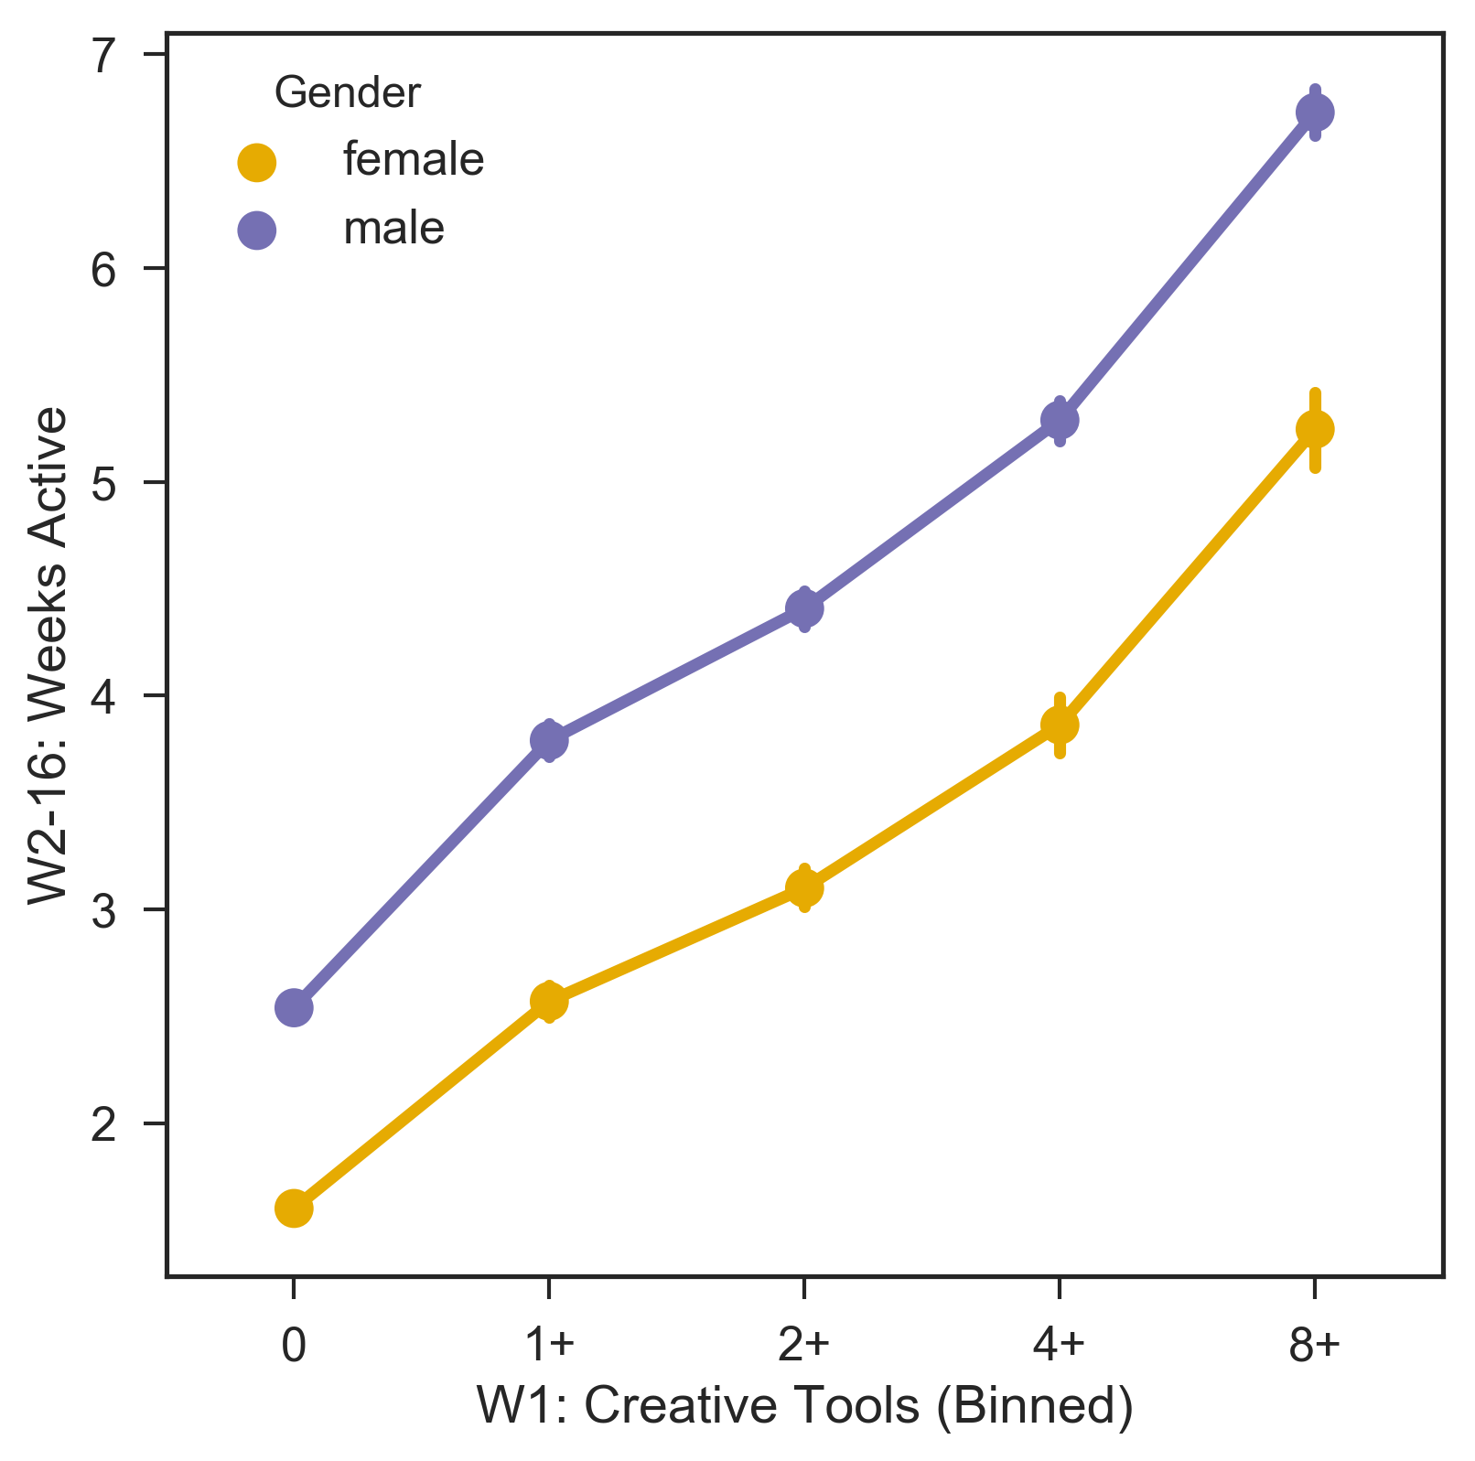
W2-16: Weeks Active ~ W1: Creative Tools (Binned) + Gender - 16 Week Window

Slide 33
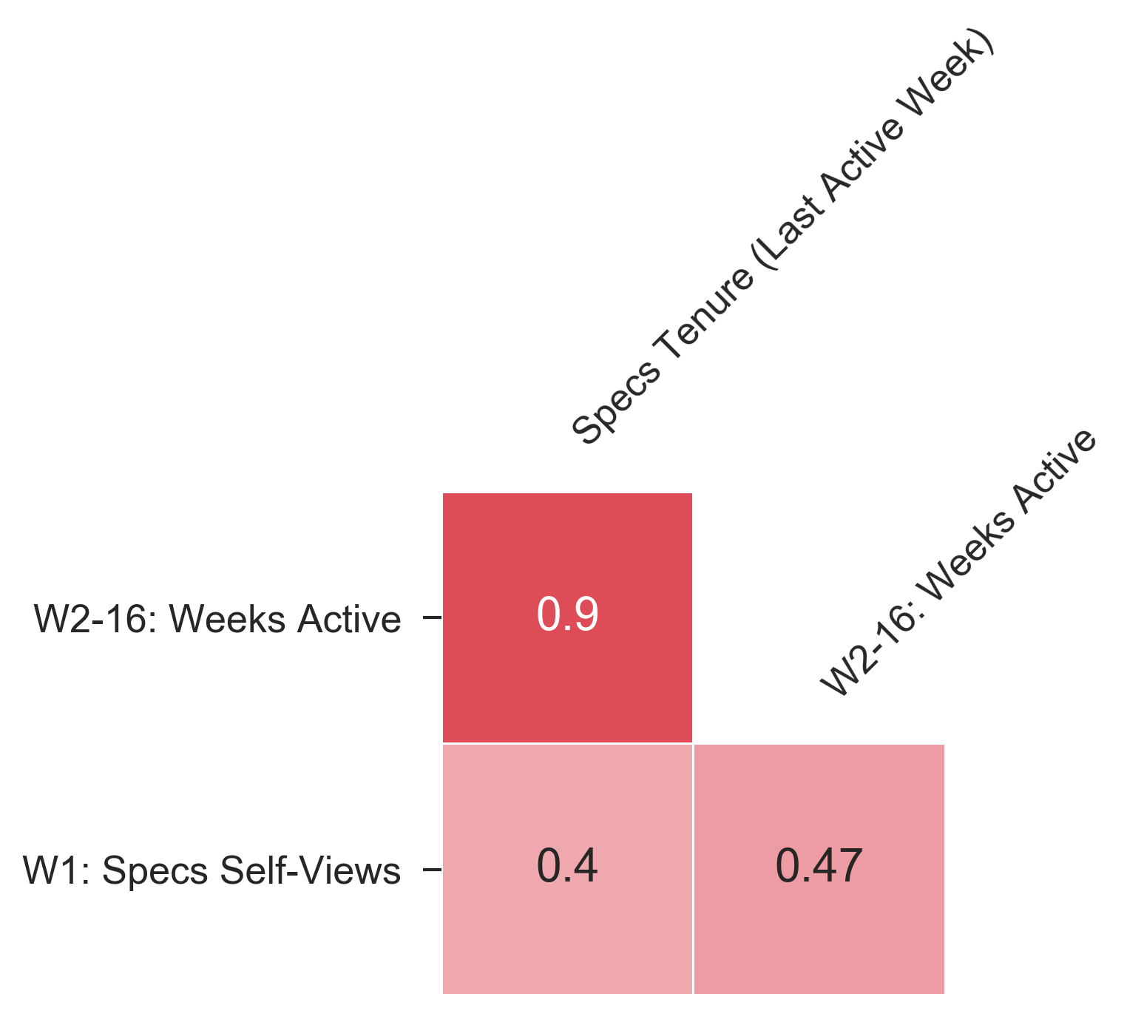
CORRELATION PLOT Self-Views

Slide 34
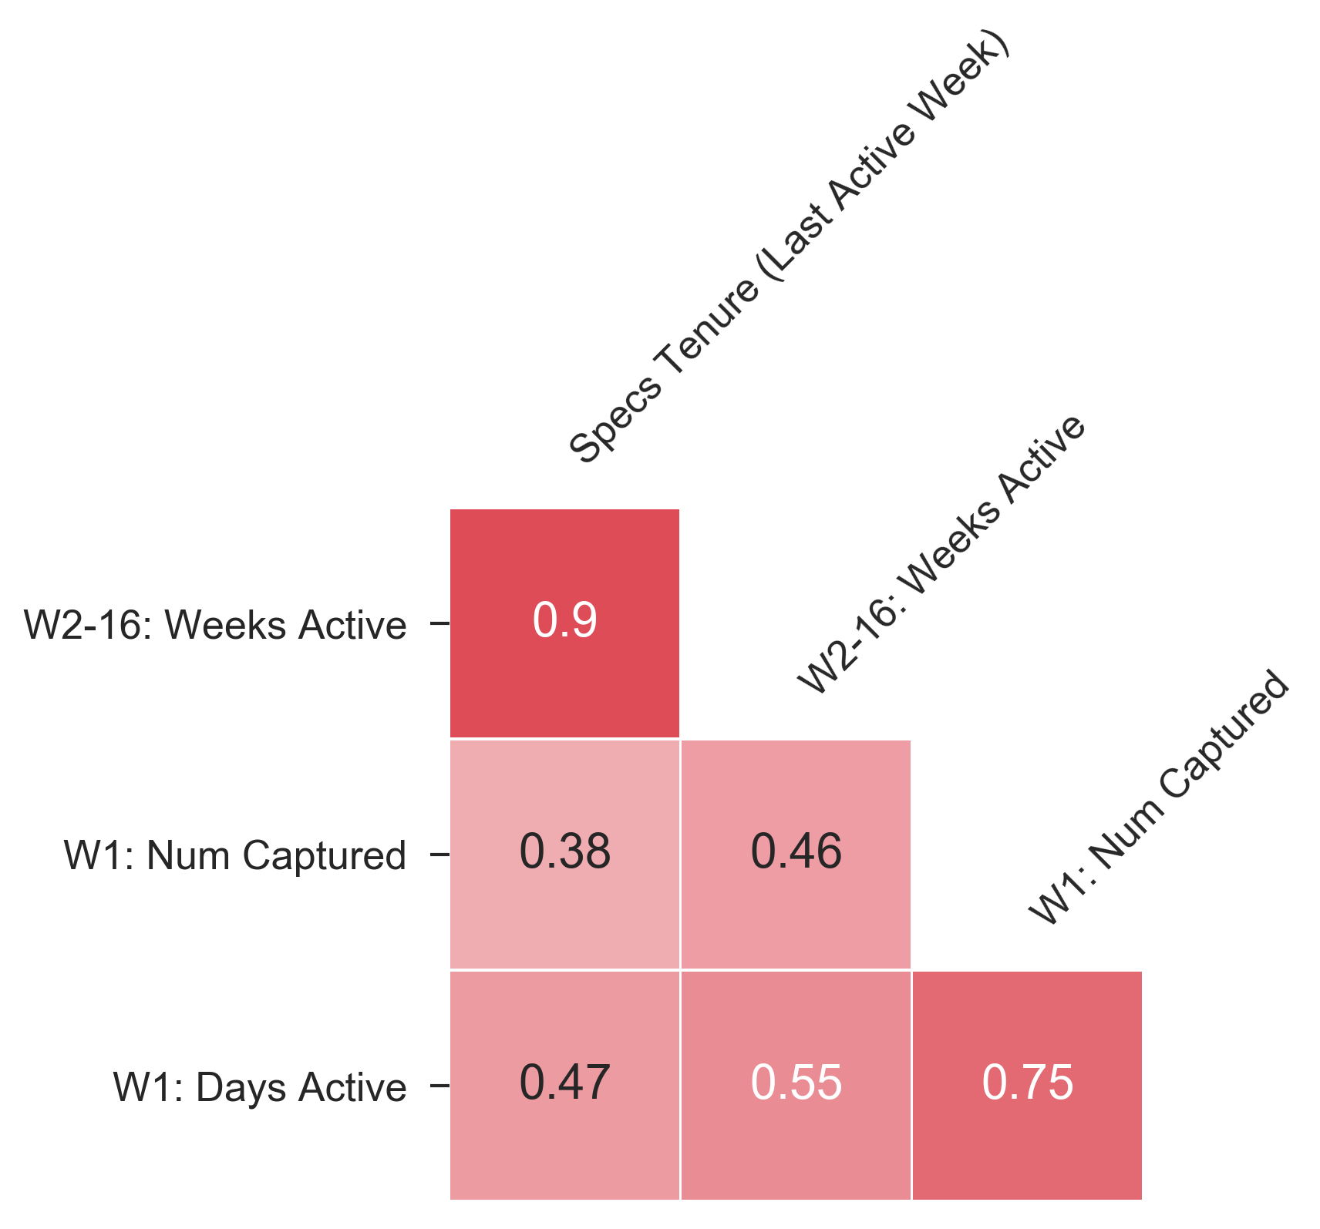
CORRELATION PLOT Short-Term Usage Specs

Slide 35
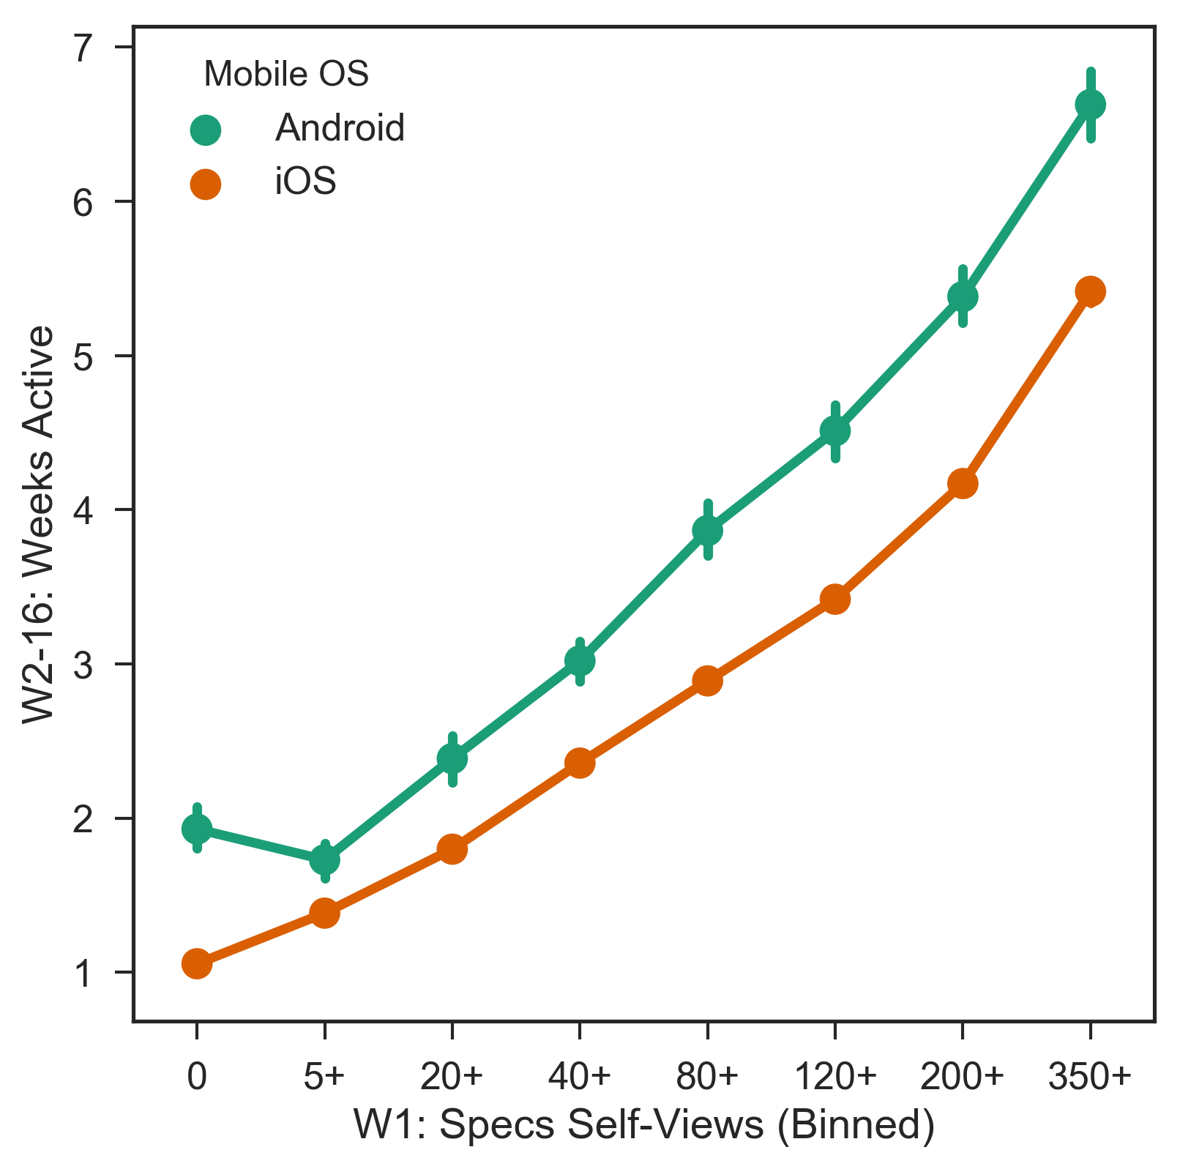
W2-16: Weeks Active ~ W1: Specs Self-Views (Binned) + Mobile OS - 16 Week Window

